Slide 1
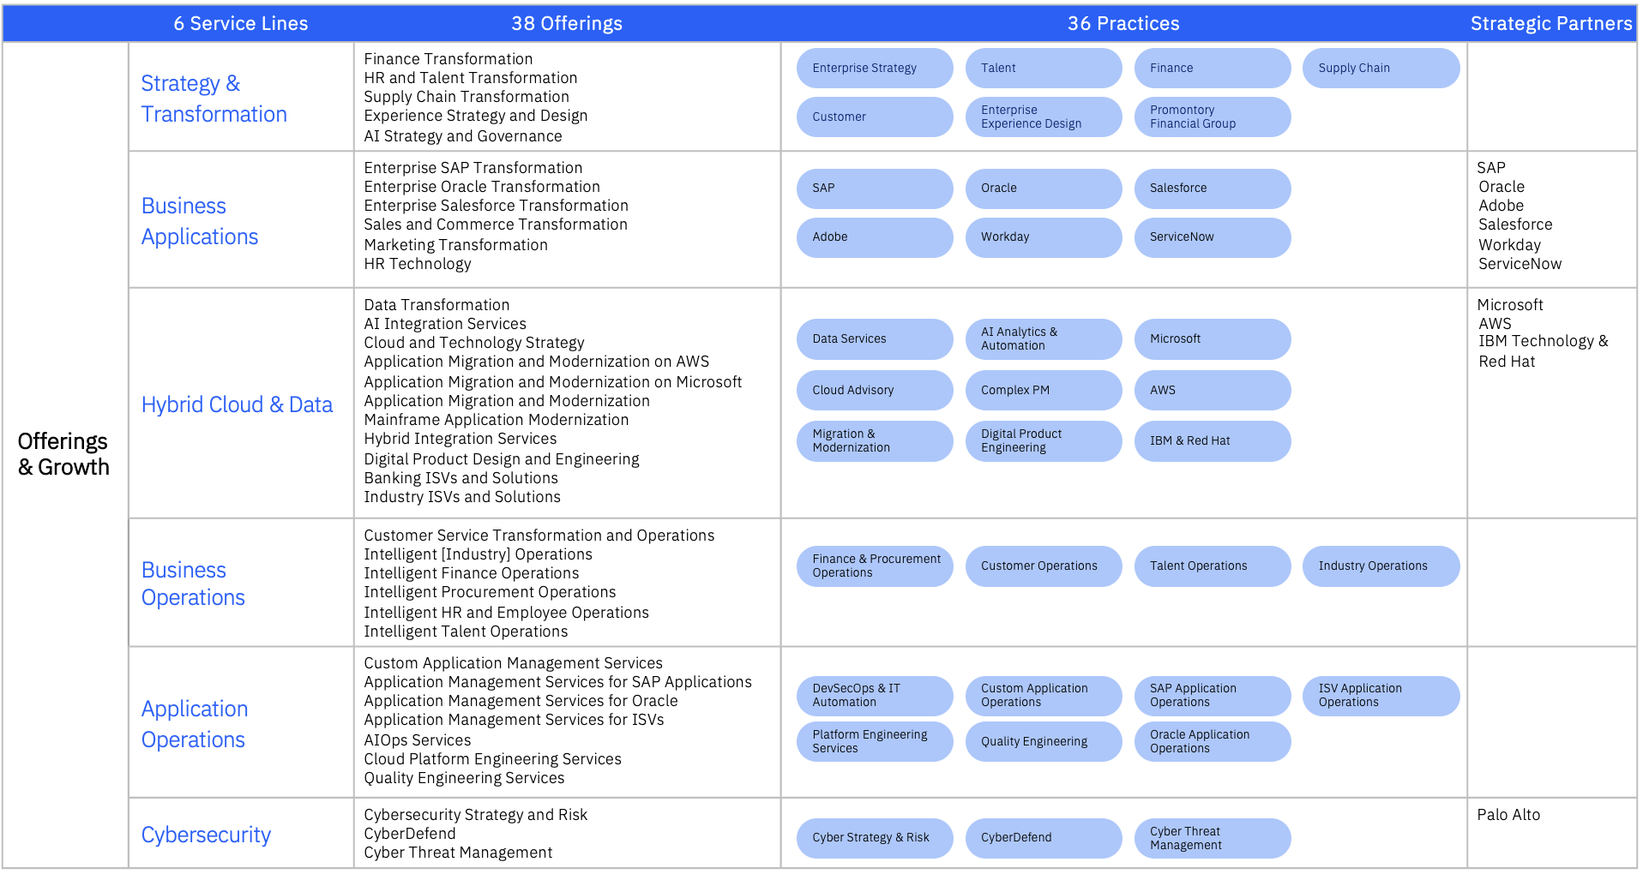

Slide 2
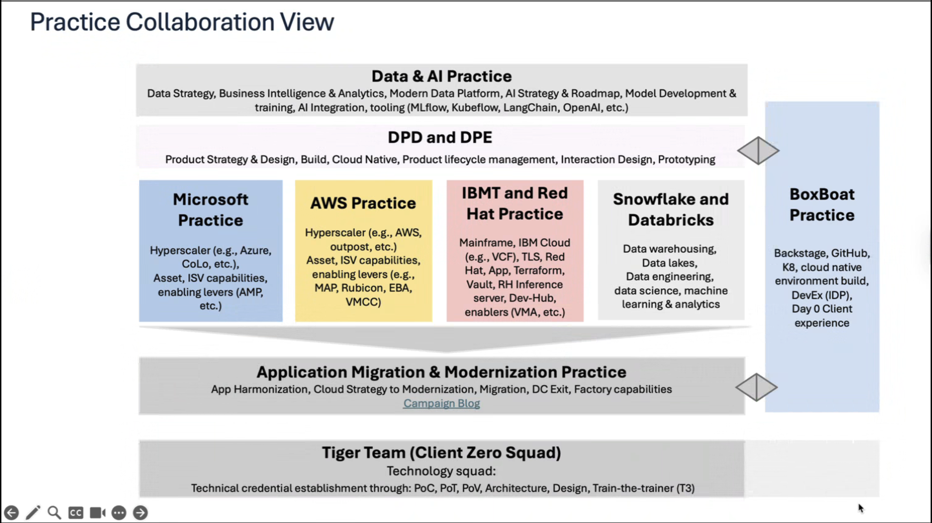

Slide 3
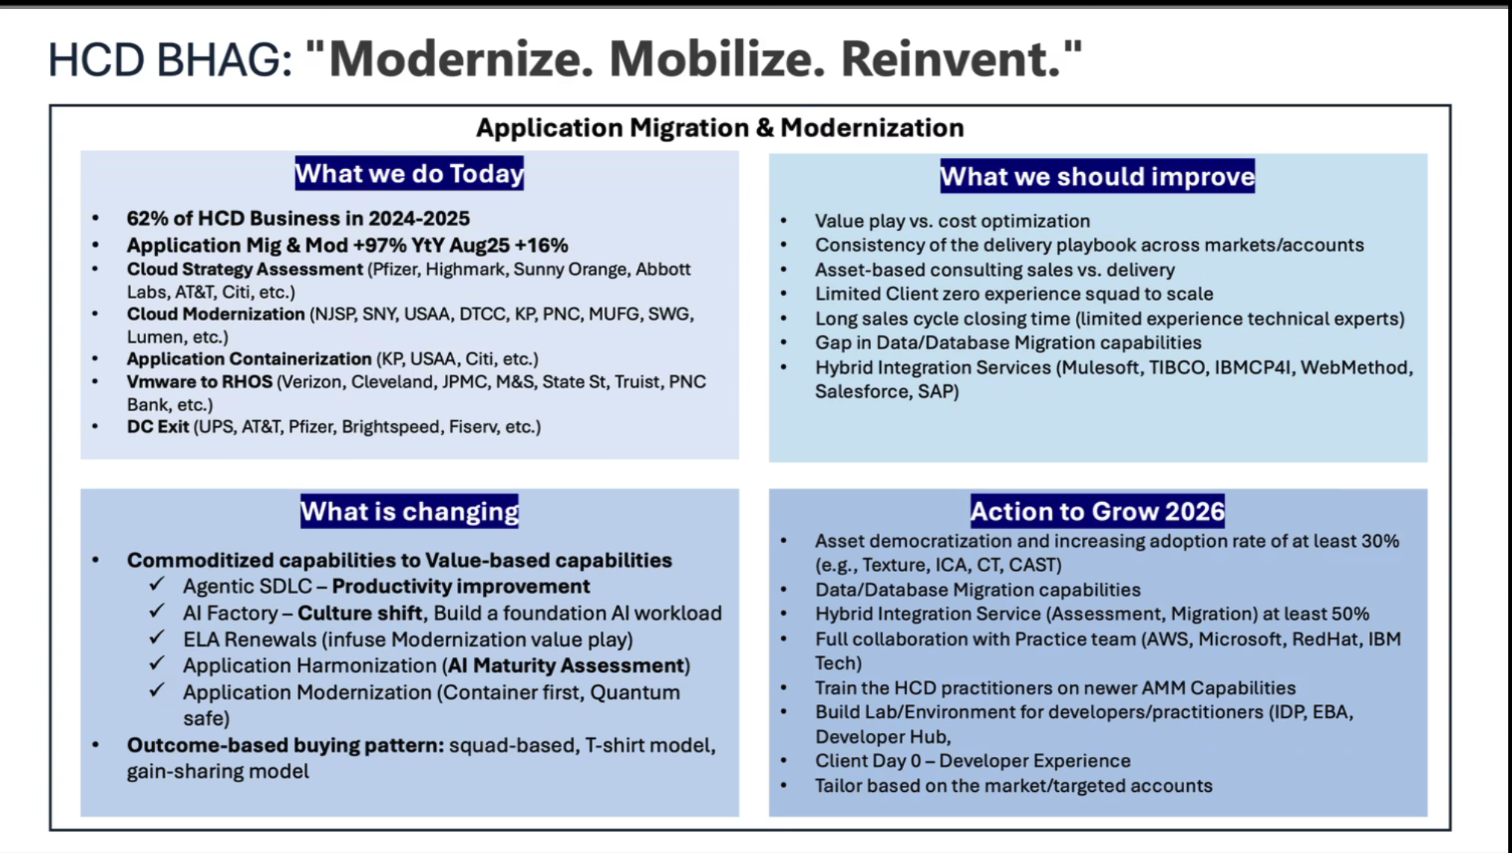

Slide 4
Demonstrating our assets/ products to drive acceleration and value with Hybrid by Design
IBM Assets
Transformation Areas
Capability
Domains
DAY 0
DAY 1
DAY 2
Product-led
CAT( HBD, ETOM), ICCA, IGX, CBM.Ai
ICCA( MAM, ARC), CMA, IGX, , CBM.Ai
ICCA Playbook
Product-led
by Design
Process & Organization
CAT (HBD, ETOM, FinOps), ApptioOne, CBM.Ai
ApptioOne, CBM.Ai
ApptioOne , Cloudability
People & Culture
CAT(ETOM, HBD), IT Talent Marketplace, Talent & Transformation Assets
Talent & Transformation Assets
ICCA Playbook
Platform Operations
CAT(HBD, ETOM, FinOps), PRISM (Architecture Blueprints)
PRISM (Hybrid Cloud Control Plane, IBM Multicloud Fleet Control, AutoBackup, Machine Image Toolkit, DevOps Commander
PRISM (Hybrid Cloud Control Plane, IBM Multicloud Fleet Control, AutoBackup, Machine Image Toolkit, DevOps Commander, IBM Consulting AIOps
Integration
by Design
Integration Experience
CAT, Hybrid Architecture Kit
Coexistence Playbook, Hybrid Architecture Kit
Integration Platform
CAT, Cognitive architect
PRISM (Hybrid Cloud Control Plane), DevOps Commander, Intelligent Integration Engine
PRISM (Hybrid Cloud Control Plane), Lightweight Master Data Management, Auto-ETL on Azure
Security & Compliance
Rapid Cloud & Data Security Posture Assessment; Cloud Security Maturity Modeling, IBM Concert
Active Governance Framework Accelerator; Secure By Design domain accelerators, IBM Concert
IBM Managed Security Service Platform for hybrid cloud security controls, PRISM (Secure by Design GPTs, Automation Library), IBM Concert
Gen AI Models & Platform
IBM Consulting Advantage Assistant (Discovery Assistant Pack), GenAI Data Platform Genius
IBM Consulting Advantage Assistant (Migration and, Modernization Assistant Pack), Data and AI Marketplace, GenAI Data Migration Assistant
IBM Consulting Advantage Assistant (Manage Pack), AI Marketplace Platform (ATOM), IBM Consulting Advantage Assistant (Security Pac)k
Data Sharing & Governance
DreamInitiator, DreamAdvisor, Data Quality & Data Reconciliation
Data Migration Assistant, Data Product Console, Cognitive Classifier, Lightweight Master Data Management
Auto-ETL on Azure, Intelligent Workflows, BI & Visualization, Truedat Data Catalog
Technology
by Design
Development Platform
CAT, ICCA, IBM Consulting AIOps Playbook
DevOps Commander, CTA, CMA, DMB,
Code Transporter/CTI, Red Hat MTA, PRISM (Developer eXperience Portal), IDCP
DevOps Commander, IBM Consulting AIOps, PRISM (Developer eXperience Portal)
K8s & Hosting Platform
Hybrid Cloud Architecture Kit (HAK),PRISM Architecture Blueprints & Control Plane
PRISM Architecture Blueprints & Control Plane
PRISM (Hybrid Cloud Control Plane)
Operating Platform
PRISM (Architecture Blueprints)
PRISM (Hybrid Cloud Control Plane, IBM Multicloud Fleet Control, AutoBackup, Machine Image Toolkit)
PRISM (Hybrid Cloud Control Plane, IBM Multicloud Fleet Control, AutoBackup, Machine Image Toolkit)
HCS Enablement | Hybrid by Design
Notes:
Hybrid by Design has been designed to converge the many aspects of Transformation, whilst also being comprehensive and descriptive enough to capture the uniqueness of each enterprise.
We’ll show you how it does this later.
You’ll notice there are 5 Levels for each of the Domains, While 5 is the highest level of capability, it is not necessary for all organisations to reach Level 5 across all domains. What is important is that they have the right combination of maturity to drive their Business Vision – which means prioritizing investments in the key domains that are critical.

Slide 5
Demonstrating IBM Technology Portfolio to drive acceleration and value with Hybrid by Design
Transformation Areas
Capability
Domains
Enabling IBM/RH technology – driven by 4 key platforms
Product-led
Process & Organization
IBM Consulting, Dialexa
Product-led
by Design
People & Culture
Platform Operations
HashiCorp | Terraform ● Vault
Apptio | Cloudability ● Turbonomic ● ApptioOne
Concert ● Verify ● NS1 ● SevOne
Instana ● Turbonomic ● Maximo ● Targetprocess
CP4I
Integration Experience
1
Automation platform
Integration
by Design
Integration Platform
Security & Compliance
Guardium, Verify, X-Force, FS Cloud
IBM Consulting
Gen AI Models & Platform
2
AI and Data platform
watsonx | .ai ● .data ● .gov ● Assistants
Technology
by Design
Data Sharing & Governance
Development Platform
3
Hybrid Cloud platform & Cloud Paks
4
Mainframe/ IBM Z, WCA4Z
K8s & Hosting Platform
Red Hat | OpenShift ● Enterprise Linux ● Ansible
System Z software ((Transaction Processing platform)
Automation platform
Operating Platform
HashiCorp | Terraform ● Vault
IBM Cloud, Red Hat & Hyperscaler Partners
AWS ● Azure ● GCP ● Oracle
IBM | Hybrid by Design
Notes:
IBM Advantage Assistant, Cross Domain – IGX – Product led, Dialexa – Product eng/design, Cardinal, DC, MAM, IGNITE – Day 1, Cognitive architect- Day0, CMA- Day0, DreamAdvisor, CloudPak for Data, Watson discovery- Data, CMA/CTI – day 0, Migration toolkit in Day1, RedHat developer portal – day1, CodeAssistants for- Day1, ApptioOne – Day0 and 2, Cloudability – day2, Hybrid Cloud Architecture Kit, (HAK) – K8s too – Day 0, People – IT Talent Marketplace (from BTS),
Hybrid by Design has been designed to converge the many aspects of Transformation, whilst also being comprehensive and descriptive enough to capture the uniqueness of each enterprise.
We’ll show you how it does this later.
You’ll notice there are 5 Levels for each of the Domains, While 5 is the highest level of capability, it is not necessary for all organisations to reach Level 5 across all domains. What is important is that they have the right combination of maturity to drive their Business Vision – which means prioritizing investments in the key domains that are critical.

Slide 6
Build the Control Plane. Upgrade DevEx. Ship with Confidence.
Four programmatic offerings that standardize platforms, automate everything, and make the SDLC agentic and secure across hybrid cloud.
Automation Transformation
Cloud-Native Foundations (Day 0)
Enterprise automation at scale—IaC (Terraform), Ansible Automation Platform, and GitOps—to standardize infra, platforms, and app operations.
Reduce toil with reusable modules and policy-as-code.
Shorten environment lead time; auditable, repeatable changes.
Stand up an Automation CoE & golden playbook catalog.
Opinionated platform baseline for hybrid cloud with a Multi-Cloud Control Plane (ACM), Day-0→Day-1 readiness, and IDP integration.
Faster, safer app landings across on‑prem, public cloud, and edge.
Fleet policy, security, and SRE runbooks baked in from day one.
Standard stamps for clusters, networking, observability, and DR.
Modern & Agentic SDLC (DevEx)
VMware Estate Transformation
SDLC uplift (CI/CD, GitOps, secure supply chain) plus agentic developer assistants and IDP golden paths for consistent delivery.
Improve DORA metrics with golden pipelines and ACS-gated security.
Developer portals (RHDH/Backstage) and paved paths for teams.
Governed Copilot/Duo/Q usage, repo hygiene, and guardrails.
Structured path from VMware to Red Hat OpenShift Virtualization—then progressive container modernization with a migration factory.
Portfolio assessment → pilot → waves with repeatable runbooks.
RHOV + ACM‑V + MTV patterns; rollback and DR by design.
TCO transparency and a runway to cloud‑native services.
Start here: 90‑min Executive Briefing → 1‑day Workshop → Paid Assessment → PoV in your tenant → Scale with a CoE
Proof: DevEx outcomes (lead time ↓, MTTR ↓), audited supply chain, and standardized platform ops across hybrid.

Slide 7
Automation Transformation
Enterprise automation at scale — IaC, Ansible Automation Platform, and GitOps.
What it is & Key Plays
Business Outcomes & Artifacts
What it is
Outcomes
Standardize infra, platform, and app operations via Terraform, AAP, and GitOps with policy‑as‑code and a CoE.
Reduce toil & snowflakes; auditable changes.
Faster env turn‑ups; consistent security & policy.
Hardened runbooks; measurable MTTR/lead‑time deltas.
Plays
Artifacts & Proof
AWX → AAP upgrade & scale (content signing, Automation Hub).
Infra IaC baseline (multi‑cloud landing zones as code).
Cluster & platform GitOps (ACM + Argo; ZTP/Day‑2 ops).
Release‑ready automation (pre/post‑deploy hooks, evidence).
Automation CoE charter; golden modules & policy bundle.
Runbooks & dashboards; ROI baseline vs target.
Assessment → PoV on one platform stamp → scale.
Engagement ladder: Exec Briefing → 1‑day Workshop → Assessment → PoV → Scale with a CoE

Slide 8
Cloud‑Native Foundations (Day 0)
Hybrid‑by‑Design platform baseline and Multi‑Cloud Control Plane (ACM).
What it is & Key Plays
Business Outcomes & Artifacts
What it is
Outcomes
Opinionated platform baseline across on‑prem, public cloud, and edge with Day‑0→Day‑1 readiness and IDP integration.
Faster, safer app landings; standardized operations.
Central policy/compliance; reduced variance across fleet.
SRE & security baked in; predictable reliability/costs.
Plays
Hybrid‑by‑Design workshop → Control Plane architecture.
Unified app platform (OCP/xKS, registry, networking, obs).
Edge/remote stamps (SNO/Device Edge, hub‑spoke mgmt).
IDP Day‑0 enablement (RHDH/Backstage golden paths).
Resilience & DR (OADP + storage); FinOps with KubeCost/Turbo.
Artifacts & Proof
Reference architecture & platform stamp catalog.
Policy sets, SRE runbooks, cost & reliability baselines.
HBD Workshop → Enablement → Consolidation PoV.
Engagement ladder: Exec Briefing → 1‑day Workshop → Assessment → PoV → Scale with a CoE

Slide 9
Modern & Agentic SDLC (DevEx)
CI/CD + GitOps + secure supply chain with agentic assistants and IDP golden paths.
What it is & Key Plays
Business Outcomes & Artifacts
What it is
Outcomes
End‑to‑end SDLC uplift, developer portals, and governed AI copilots; measurable improvements in DORA metrics.
Higher deployment frequency, lower change‑fail rate.
Consistent golden paths; faster onboarding & delivery.
Security evidence embedded in the release process.
Plays
DevOps maturity assessment → operating model & RACI.
CI/CD modernization (GitHub/GitLab/Tekton; GitOps).
Trusted Software Supply Chain (SLSA, SBOM, attestations).
IDP deployment & plugin dev (RHDH/Backstage).
Agentic SDLC enablement (Copilot/Duo/Q, policies, hygiene).
Engineering productivity benchmarks (DORA/Jellyfish).
Artifacts & Proof
SDLC reference arch; pipeline blueprints; policy pack.
IDP templates; AI usage policy; metric dashboards.
DevEx Assessment → Team trials/office hours → Transformation.
Engagement ladder: Exec Briefing → 1‑day Workshop → Assessment → PoV → Scale with a CoE

Slide 10
VMware Estate Transformation
Structured path from VMware to Red Hat OpenShift Virtualization (RHOV) then to containers.
What it is & Key Plays
Business Outcomes & Artifacts
What it is
Outcomes
Programmatic migration to RHOV with migration factory and progressive modernization to containers/services.
Licensing/TCO control and modernization runway.
Operational consistency via ACM‑V and GitOps.
Reduced risk with repeatable wave‑based execution.
Artifacts & Proof
Plays
Migration roadmap; wave plan; TCO/ROI model.
Ops guide; rollback plan; post‑cutover metrics.
Assessment → Pilot → Waves → Modernize.
Virtualization assessment (portfolio, target design, ops).
Pilot/PoC of RHOV features with real workloads.
Migration factory (waves, MTV + AAP runbooks).
Modernize post‑migration (CI/CD, GitOps, IDP).
DR/rollback patterns; HCI/storage integration as needed.
Engagement ladder: Exec Briefing → 1‑day Workshop → Assessment → PoV → Scale with a CoE

Slide 11

The SDLC Modernization Journey
Customer Challenges
Offering Pillars
Capabilities
Difficult to source automation
No developer productivity metrics
Misalignment of business OKRs to development activities
Self-service automation
Developer productivity metrics and measurement
Alignment of productivity metrics to business OKRs and KPIs
Developer Productivity & Portals
Disparate app platforms – VMs, Serverless, Containers, AI/ML
Need for approach on leveraging AI across the enterprise
Standardized application hosting
Standardized, reusable automation templates
AI integrations at every level
Maturity
Unified App Platform
Siloed cloud and on-prem environments
Lack of centralized monitoring and observability
Non-cohesive inventory tracking
Centralized management of cloud and on-prem resources
Standardized release engineering processes
Hybrid & Edge Infrastructure
Multiple tools for the same job
Heavy on manual processes
Implementations for similar tasks are not consistent
High operational overhead
DevOps Toolchain consolidation
CI/CD, IaC, and Configuration automation
DevOps Transformation
Release Engineering
SDLC Transformation
AI Integration
IT Transformation

Slide 12





BoxBoat Offerings
Developer Experience by Design
”DevEx” is for more than just Developers. Achieving the Ideal Developer Experience requires transforming the entire IT estate, benefiting every team from devs, operations, infrastructure, security, etc. By approaching your ecosystem with a DevEx by Design mindset, you can transform your entire operating model, bringing your enterprise into the modern cloud native world.
Developers
Infra/Ops
Security
Hybrid & Edge Infrastructure enables a standardized approach to deployments in any environment. We can develop an abstraction layer across every public/private cloud, with a full suite of automation to remove the headache of managing multiple disparate platforms. This standardizes operations for all environments.
Unified Application Platform provides the next layer on top of your infrastructure, enabling every workload to run on any environment, all with parity across the entire stack. Devs don’t have to be concerned with where to deploy their VMs vs containers, or which environment supports ML workloads.
Standardized deployments
Platform parity across estate
Golden guardrails
DevOps Transformation takes a holistic approach to transforming the entire IT estate through a detailed gap analysis between existing procedures and business goals. Teams will be enabled by enhanced processes & operating models and a standardized approach to tooling.
Release Engineering looks across the entire SDLC, including post-deployment into operations, to optimize for a cloud native landscape. Ops will manage only one secured standard across the enterprise, and devs can rely on robust automation, a full suite of modern technologies, and standardized environments.
AI-Ready Platforms & Enablement
Developer Productivity & Portals
Developer Productivity & Portals is the final piece, tying the entire ecosystem together behind a single-pane-of-glass. Devs can access a catalog of golden paths, automating deployments to standardized platforms with cloud native toolsets.
AI-Ready Platforms & Enablement creates an ecosystem to facilitate AI development and integrations into the dev & ops processes. This enables parity across toolsets for Ops.
DevOps Transformation
Release Engineering
Unified Application Platform
Hybrid & Edge Infrastructure
Physical
Virtual
Private Cloud
Public Cloud
Managed Cloud
12

Slide 13




IBM Consulting and Red Hat Incentives
OpenShift Everywhere POC (OSE)
VMware Solution Assessment
Red Hat Consulting Partner Program
(CPP)
Red Hat Certification Funding
Why: Experiential, collaborative selling to prove value of Red Hat technologies
Why: Showing the value of OpenShift virtualization and OpenShift as a VMware alternative
Why: Incentive for growth and use of Red Hat technologies
Why: Earn Blue Points for every Red Hat Certification (new or renewal) completed between January 1, 2025 and Dec 31, 2025.
Value: Red Hat will reimburse 50% of the account-funded B&P spend on all approved POCs, up to $50K
Eligible for OpenShift, ACM/ACS, OpenShift Virtualization, ROKS, ROSA, ARO, Ansible Automation and RH Middleware use cases.
Value: Red Hat will reimburse 100% of the account-funded B&P spend, up to $50K for IBM Consulting’s VMware Rapid Assessments where OpenShift Virtualization or OpenShift is positioned
Pre-approval is required before the assessment begins. Expense benefit is credited back to the account after proof of completion
Value: Red Hat will return a benefit of 15% of the Annual Contract Value (ACV) of Red Hat Subscription Sales where IBM Consulting is instrumental
Pre-approval is required. Expense benefit is credited back to the account after deal is signed.
Value: Red Hat will fund the program to provide Blue Points for obtaining a Red Hat Certification
Eligible for all IBM Consulting Practitioners from January 1st 2025 to December 31st 2025.
Incentives to help drive pipeline creation and progression to land and expand our 4 key sales plays.
RESOURCES
RESOURCES
RESOURCES
RESOURCES

Slide 14
BoxBoat’s Offerings
Offering Pillars
Core Offerings
Offering Sub-pillars
Security & Compliance
Resilience & DR
Governance & Policy
Talent & Enablement
Unified App Platform
K8s (OCP, xKS, etc)
RHOV
IBM-T LZs (Maximo)
ACS
Platform CoE
Release Engineering
Declarative Platforms
Declarative Workloads
Zero Touch, Zero Trust
Automation CoE
Hybrid & Edge Infrastructure
ACM
ACS
Declarative Clusters/ZTP
Hybrid Cloud CoE
HBD Workshop
Developer Productivity & Portals
IDP Deployment
Plugin Development
Developer Advantage
Golden Guardrails
DevOps CoE
DevOps Transformation
DevOps Capabilities Eval
GitHub Actions
Shift Left
GH Enablement
Ideal
Developer Experience
Notes:
Partner sub-pillar

Slide 15
Our Core Capability is to improve Developer Experience…
Offering Pillars
Core Offerings
Offering Sub-pillars
Security & Compliance
Resilience & DR
Governance & Policy
Talent & Enablement
FinOps & Sustainability
Unified App Platform
K8s (OCP, xKS, etc)
RHOV
IBM Software LZs
(Maximo)
ACS
OADP/3rd Party
Platform CoE
Cloud Native Fundamentals
KubeCost
Release Engineering
Declarative Platforms
Declarative Workloads
Next Gen DC
Zero Touch, Zero Trust
EaC
Automation CoE
CI/CD & DevOps Fundamentals
Turbonomic
Hybrid & Edge Infrastructure
ACM
Hybrid Cloud Control Plane
Hub & Spoke Orchestration
Zero Touch, Zero Trust
Declarative Clusters/ZTP
Hybrid Cloud CoE
HBD Workshop
Live Cost Metrics
Developer Productivity & Portals
IDP Deployment
Plugin Development
Developer Advantage
Golden Guardrails
Shifting Resilience Left
DevOps CoE
Dev Advantage Onboarding
IDP Dynamic Deployments
DevOps Transformation
DevOps Capabilities Eval
GitHub Actions
Eng Productivity Benchmark
TSSC
NFRs and SLx
Cloud Native ETOM
GH Enablement
SRE
AI‑Ready Platforms & Enablement
ICA/watsonx
RH Inference Server /
InstructLab
RHOAI
Auto-remediation
EDA
watsonX
Copilot Enablement
GenAI FinOps
Ideal
Developer Experience
Notes:
Partner sub-pillar

Slide 16
BoxBoat’s Offerings
+ IBM Consulting
+ Partners
Offering Pillars
Core Offerings
Offering Sub-pillars
Standard Offerings
Security & Compliance
Resilience & DR
Governance & Policy
Talent & Enablement
FinOps & Sustainability
Partner/ Other IBM Solutions
Unified App Platform
K8s (OCP, xKS, etc)
ACS
Platform CoE
Release Engineering
Declarative Platforms
Zero Touch, Zero Trust
Automation CoE
Turbonomic
Hybrid & Edge Infrastructure
ACM
ACS
Declarative Clusters/ZTP
Hybrid Cloud CoE
HBD Workshop
Dell APEX
Developer Productivity & Portals
IDP Deployment
Golden Guardrails
DevOps CoE
Apptio
Dialexa Backstage Dev
DevOps Transformation
DevOps Capabilities Eval
Shift Left
GH Enablement
SRE
AI‑Ready Platforms & Enablement
ICA/watsonX
watsonX
Copilot Enablement
AIOps
Ideal
Developer Experience
Notes:
Partner sub-pillar

Slide 17


Unified App Platform
BoxBoat’s Offerings
IBM Software LZ
Complex Platform CoE
RHOV
App Platform Modernization
Architecture, deployment, and configuration of OpenShift cluster with necessary platform services and integration for deploying/migrating IBM software.
Development of a CoE with a set of best practices for platforms in a single cloud or across a hybrid cloud environment, such as for Hybrid Cloud Control Plane.
Architecture, deployment, and configuration of OpenShift Virtualization cluster with necessary platform services for specific VM workloads.
Replatform workloads from legacy to cloud native. Modernize and standardize platform services.
Use Cases:
Deploying or updating Maximo
Deploying ICA in customer env
Use Cases:
Standard multi-environment platform for all workloads
Use Cases:
Deploying VMs on a cloud native platform
Migrating away from VMware
Use Cases:
Developing a platform for a net new move to containers at scale
Migrating from Tanzu to xKS/RHOS
Lead Products: OpenShift, AAP, GitOps
Lead Products: OpenShift, xKS, ACM/OCM, Rancher, AAP, Terraform, GitOps
Lead Products: OpenShift, RHOV, ACM-V, AAP, IDP, MTV, GitOps
Lead Products: OpenShift, xKS, Rancher
Container Platform Assessment
Cloud-Native Platform
Complex Service Mesh
Offering
Description
Description
Description
Description
Strategy
Implementation
Use Cases:
Security & Compliance
Use Cases:
Use Cases:
Use Cases:
Resilience & DR
Governance & Policy
Lead Products:
Lead Products:
Lead Products:
Lead Products:
Talent & Enablement

Slide 18
BoxBoat’s Offerings
Release Architecture Assessment
Automation CoE
CI/CD Modernization
GitOps Framework
Release Engineering
Evaluate existing CI/CD tooling, IaC maturity, GitOps adoption, etc. Develop project plan for improving maturity with combined tech and process transformation.
Development of a CoE with a set of best practices for IT automation across an enterprise.
Development of a net new set of pipelines or migration of existing pipelines in a legacy platform. Full integration with all necessary tooling.
Description
Use Cases:
Modernizing from legacy tooling
Migrating to a cloud native platform
Struggles with toolchain spread
Use Cases:
Standardized automation for deploying environments, platforms, or workloads.
Use Cases:
GitHub Actions pipeline creation
Migration from Jenkins to GH/GL
Use Cases:
Lead Products: GitHub Actions, GitLab Pipelines, Tekton, GitOps, Terraform
Lead Products: AAP, GitOps, Terraform
Lead Products: GitHub Actions, GitLab Pipelines, Jenkins, Tekton
Lead Products:
Pipeline Optimization
Secure Software Supply Chain
Zero-touch Delivery
Offering
Description
Description
Description
Description
Strategy
Implementation
Use Cases:
Security & Compliance
Use Cases:
Use Cases:
Use Cases:
Resilience & DR
Governance & Policy
Lead Products:
Lead Products:
Lead Products:
Lead Products:
Talent & Enablement

Slide 19
BoxBoat’s Offerings
DevOps Maturity Assessment
DevOps Operating Model
DevOps Enablement Workshops
Engineering Productivity Benchmarking
DevOps Transformation
Evaluate teams’ DevOps maturity and define a transformation roadmap.
Define the DevOps roles, responsibilities, and shared services.
Hands-on workshops for tools, processes, and team enablement.
Analyze productivity metrics and propose tooling/process improvements.
Use Cases:
Modernizing for cloud native
Considering toolchain optimization/consolidation
Use Cases:
Platform team chartering
New entrance to DevOps practices
Use Cases:
GitHub Actions enablement
Use Cases:
Preparing for IDP deployment
Business case prep for a major transformation effort
Lead Products:
Lead Products:
Lead Products:
Lead Products: GitHub, GitLab, Jellyfish, DORA, Space
Offering
Offering
Offering
Offering
Description
Description
Description
Description
Strategy
Implementation
Use Cases:
Security & Compliance
Use Cases:
Use Cases:
Use Cases:
Resilience & DR
Governance & Policy
Lead Products:
Lead Products:
Lead Products:
Lead Products:
Talent & Enablement

Slide 20
BoxBoat’s Offerings
Hybrid Cloud Architecture Assessment
Edge Orchestration
HCI & Storage Strategy
Platform Infra Automation
Hybrid & Edge Infrastructure
Evaluate readiness and design for hybrid or multi-cloud topology.
Deploy container platforms to edge locations or non-cloud environments.
Recommend storage solutions for scalable, resilient edge/cloud platforms. Includes dedicated storage or HCI as well as Software-defined storage.
Automate provisioning of clusters using GitOps and bare metal tools.
Use Cases:
Azure & on-prem integration
Expansion to additional clouds
Vendor lock-in concerns
Extremely high SLA requirements
Use Cases:
Use Cases:
Modernizing from legacy platforms to cloud native
Persistent and resilient storage patterns
Use Cases:
Lead Products:
Lead Products: OpenShift, SNO, RHEL Device Edge, Rancher, ACM
Lead Products: ODF, Ceph, Portworx, NetApp, Dell, IBM Fusion
Lead Products:
Edge Automation w/ FDO & AAP
Hub & Spoke Multi-cluster Design
Offering
Offering
Automate zero-touch provisioning and bootstrapping of edge devices.
Architect and deploy multi-cluster governance and control.
Description
Description
Strategy
Implementation
Use Cases:
Security & Compliance
Use Cases:
Use Cases:
Use Cases:
Resilience & DR
Governance & Policy
Lead Products:
Lead Products:
Lead Products:
Lead Products:
Talent & Enablement

Slide 21
BoxBoat’s Offerings
Developer Advantage
IDP Deployment
IDP Plugin Development
Jellyfish Metrics
Developer Productivity & Portals
Description
Build and customize a developer portal with plugins and integrations.
Description
Description
Use Cases:
Use Cases:
Use Cases:
Use Cases:
Lead Products:
Lead Products:
Lead Products:
Lead Products:
Managed IDP
Golden Path Development
Offering
Offering
Description
Description
Description
Description
Strategy
Implementation
Use Cases:
Security & Compliance
Use Cases:
Use Cases:
Use Cases:
Resilience & DR
Governance & Policy
Lead Products:
Lead Products:
Lead Products:
Lead Products:
Talent & Enablement

Slide 22
BoxBoat’s Offerings
ICA Platform
AI Platform Readiness Assessment
Foundational AI Infrastructure
Offering
AI-Ready Platforms & Enablement
Description
Build and customize a developer portal with plugins and integrations.
Description
Description
Use Cases:
Use Cases:
Use Cases:
Use Cases:
Lead Products:
Lead Products:
Lead Products:
Lead Products:
Offering
Offering
Offering
Offering
Description
Description
Description
Description
Strategy
Implementation
Use Cases:
Security & Compliance
Use Cases:
Use Cases:
Use Cases:
Resilience & DR
Governance & Policy
Lead Products:
Lead Products:
Lead Products:
Lead Products:
Talent & Enablement

Slide 23
BoxBoat’s Offerings
Offering Pillars
Core Offerings
Offering Sub-pillars
Security & Compliance
Resilience & DR
Governance & Policy
Talent & Enablement
Unified App Platform
Release Engineering
GitHub Actions, Copilot, etc
Hybrid & Edge Infrastructure
Developer Productivity & Portals
DevOps Transformation
Notes:
Automation – Design pillar
DevOps Transformation – Implementation pillar

Slide 24
BoxBoat’s Offerings
Offering Pillars
Core Offerings
Offering Sub-pillars
Security & Compliance
Resilience & DR
Governance & Policy
Talent & Enablement
Unified App Platform
VMware Estate Transformation
Release Engineering
Hybrid & Edge Infrastructure
Developer Productivity & Portals
DevOps Transformation
Notes:
Automation – Design pillar
DevOps Transformation – Implementation pillar

Slide 25
BoxBoat’s Offerings
Offering Pillars
Core Offerings
Offering Sub-pillars
Security & Compliance
Resilience & DR
Governance & Policy
Talent & Enablement
Unified App Platform
DevEx Maturity Accelerator
Release Engineering
Hybrid & Edge Infrastructure
Developer Productivity & Portals
DevOps Transformation
AI‑Ready Platforms & Enablement
Notes:
Automation – Design pillar
DevOps Transformation – Implementation pillar

Slide 26
Offering Recipe
Phases & Steps
Sales/Presales
Workshop
Every offering has a set of potential steps across the lifecycle. These vary in necessity, with some offerings requiring more presales effort, others more delivery effort, etc. These aren’t meant to be prescriptive but rather serve as a catalog of options.
Assessment
Demo
Business Case
PoC
Pilot
Sales/Presales
Workshop
Prove Solution/Tech
Assessment
Demo
Business Case
PoC
Pilot
Full Proposal
Delivery
Assessment
PoV
CoE/Advisory
Pilot
Full Engagement
Enablement
Full Proposal
Offering
Delivery Types
Assessment
PoV
CoE/Advisory
Pilot
Full Engagement
Enablement
Notes:
PoC vs Pilot
Definition slide – include where each part falls in process

Slide 27
Opportunity Roadmap
Offering Recipe
INTERNAL ONLY
Process Overview: The sales process starts with an initial pitch, followed by a workshop to demonstrate the technology and address client questions. A discovery assessment includes a follow-up questionnaire and a leave-behind one-pager. The full assessment requires a DoU and an initial investment, which is refunded if the client proceeds. Post-engagement activities involve collecting data to improve future processes.
Client Investment: A client investment is required for the full assessment, securing client commitment and stakeholder presence to increase the likelihood of closing the deal.
**Client investment
Pitch
Workshop
Discover / Risk Assessment
Full Assessment
SOW
Post Engagement Activities
Proof of Value
**client investment should be treated as non-negotiable

Slide 28
Opportunity Roadmap
Offering Recipe
INTERNAL ONLY
Discovery and Risk Assessment: Will consist of a brief questionary to reveal the initial scope of the potential engagement, technologies, and methodologies currently being used by the client. The outcome from this is a high-level design showing the potential ROI. This will protect us from the client shopping our solution around to other vendors.
Full Assessment: To start this phase, a paid engagement is needed to perform a two-to-four-week full assessment of the client's environment. This consists of stakeholder interviews, fact gathering of the current environment, and alignment with current and long-term business initiatives. The deliverables from this are a detailed roadmap and an executive presentation of the total project business case and ROI, along with architectural design.
Proof of Value: In certain engagements with the client, a proof of value deployment is needed to demonstrate the technology in their environment with a subset of real data.
**Client investment
Pitch
Workshop
Discover / Risk Assessment
Full Assessment
SOW
Post Engagement Activities
Proof of Value
**client investment should be treated as non-negotiable

Slide 29
Opportunity Roadmap
Offering Recipe
INTERNAL ONLY
Post Engagement Activities: This phase of the roadmap is an important step in the process as it allows us to collect consultant and client feedback to improve the process and increase our ability to close future deals.
Example data points:
Client datapoints | Ratings – (1-10)
Overall Experience & Satisfaction | *
Understanding Needs & Solutions | *
Communication & Engagement | *
Proposal & Pricing | *
Client datapoints | Ratings – (1-10)
Overall Experience & Satisfaction | *
Understanding Needs & Solutions | *
Communication & Engagement | *
Areas for Improvement:
**Client investment
Pitch
Workshop
Discover / Risk Assessment
Full Assessment
SOW
Post Engagement Activities
Proof of Value
**client investment should be treated as non-negotiable

Slide 30

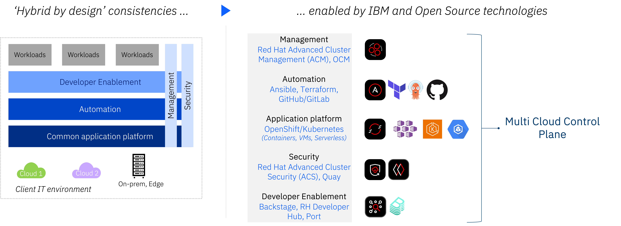
IBM Consulting Hybrid By Design: Hybrid Cloud Control Plane
Unified App Platform
Release Engineering
Hybrid & Edge Infrastructure
Developer Productivity & Portals
DevOps Transformation
Positioning and opportunity identification
Target clients are those who:
Utilize multiple public/private cloud environments to host their workloads;
Are considering adopting multiple clouds, or expanding into an additional cloud;
Desire flexibility in their choice of cloud and app platform vendors;
Require a single touchpoint for Operations and/or their end-users.
How we transact
Offering | Stakeholders
HBD Workshops | IBM
Control Plane Deployment | IBM, RH
Platform Consolidation | IBM, RH
Features and deliverables
HBD Workshops – Identify areas of improvement and develop a platform roadmap.
Solution Enablement – Design and deploy a Multi Cloud Control Plane with a governing CCoE.
Platform Consolidation – Standardize all configuration and management of all deployments behind Control Plane.
Prerequisites
Client is using/plans to use Kubernetes with multiple clusters.
Client uses/plans to use multiple clouds or has a very large single-cloud footprint.

Slide 31
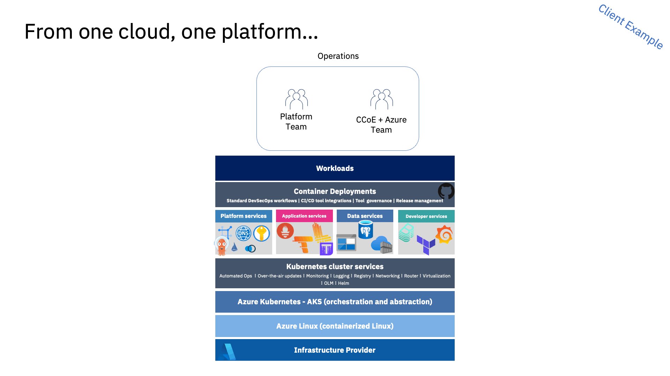

Slide 32


IBM Consulting VMware Estate Transformation: OpenShift Virtualization
Positioning and opportunity identification
Red Hat OpenShift Virtualization (RHOV) is for customers who:
Are interested in OpenShift or have long-term goals to use Kubernetes.
Want to modernize their legacy systems without rebuilding all their VMs.
May end up with a mix of traditional virtualization and cloud-native solutions for an extended period.
Want to prevent vendor lock-in.
Need time to refactor applications from VMs to containers.
How we transact
Offering | Duration | Stakeholders | eTCV
RHOV Assess | 2 weeks | IBM, RH, 3rd Parties* | $50-100k
RHOV PoC | 4-6 weeks | IBM, RH – Funded via RH or Hyperscaler | $50-100k
Pilot and Migration | 6mo-3y | IBM, RH, HW Vendor | $2-15M+
Features and deliverables
RHOV Assessment – IBM will perform a 2w assessment of the customer’s environment to architect the platform and determine migration timelines.
PoC (optional) and Pilot – Showcase capability of technology and begin migration with subset of apps.
Scaled Migration – Full migration of all target VMs to target solution.
Cloud Native Modernization – Standardize DevOps/Automation toolchains and modernize other workloads (containers, serverless, etc).
Notes
IBM-C, IBM-T, and Red Hat are partnering on many of these Assessments and pilots.
There are unique options available to IBM to enable these transformations.
Most customers will require a multi-pronged solution, necessitating IBM’s involvement
Prerequisites
Completed Rapid Assessment, or similar, to determine RHOV feasibility.
Target environment is a supported environment (some clouds are not currently supported by RHOV).
Target Package
RHOV (OVE), ACM-V, AAP, Terraform, IDP

Slide 33


Annual Subscription Estimates for full data center migration (before optimization) + Migration Services
Example
Compute Density Node Counts
Best 128c per node | Average 96c per node | Minimum 64c per node
160 nodes | 210 nodes | 315 nodes
~20k cores
160 nodes = ~$147/core
$2.95M @ MSRP*
20K cores x 189 per core =
$3,780,000
OpenShift Virtualization Engine (OVE)
+
ACM-V
+
Ansible
+
Services
210 nodes = ~$160/core
$3.2M @ MSRP*
20K cores x 160.65 per core =
$3,213,000
315 nodes = ~$188/core
$ 3.75M @ MSRP*
+ RHEL Entitlements
OpenShift Platform Plus (OPP)
+
Ansible
+
Services
315 nodes =
$5.5M @ MSRP*
RHEL Included
* Premium Support, 1 year contract

Slide 34
Virtualization migration over 2 years 50% per year
Example
CONFIDENTIAL
OVE + ACM-V + Ansible (HW only) + Services
Best Density
Avg Density
Annual Cost Quickly Reduces
Annual Cost Quickly Reduces
Savings Outperforms Costs
Savings Outperforms Costs

Slide 35



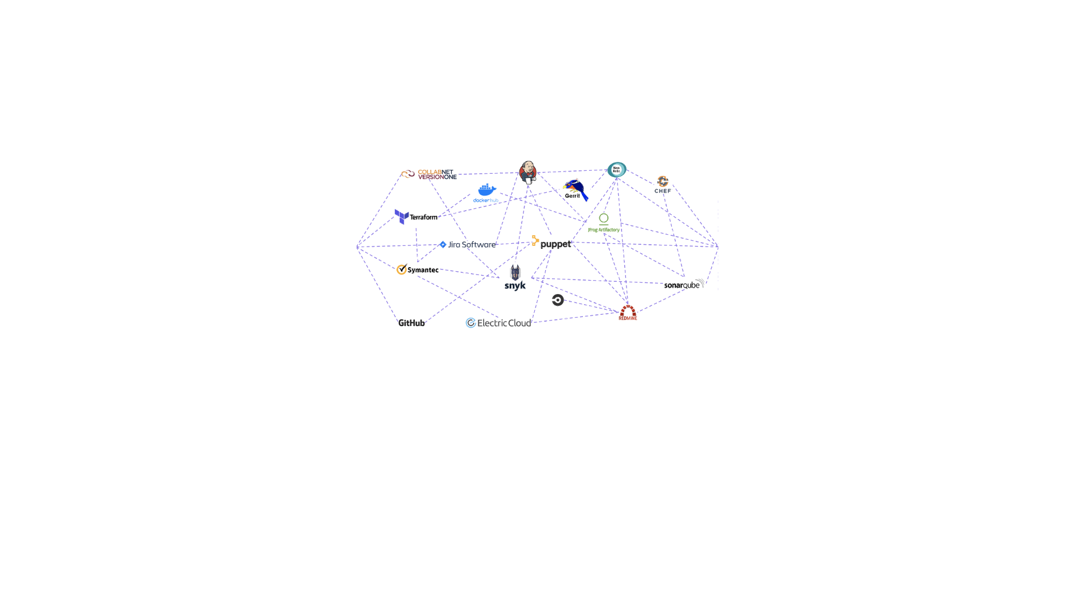
IBM Consulting DevOps Transformation
INTERNAL ONLY
Positioning and opportunity identification
Target clients are those who:
Have numerous disparate tools in their Dev(Sec)Ops toolchain (Jenkins, GitHub/GitLab, BitBucket, etc) or platform ecosystem (OpenShift, Rancher, AKS/EKS, etc).
Adopted a new cloud native or DevOps platform (see above for examples of both), but with limited adoption or lacking enablement.
Want to prepare for modernization around a cloud native platform, and/or a move to containerization.
How we transact
Offering | Duration | Stakeholders
DevOps Maturity Assessment | 2-8 Weeks | IBM
Solution Enablement | 6 Weeks | IBM, RH
DevOps Transformation | 3+ Months | IBM
Features and deliverables
DevOps Maturity Assessment – Identify areas of improvement and develop a targeted modernization strategy.
Solution Enablement – ie GitHub Actions Enablement, OpenShift Ch. 2 Expansion, etc – Short-term engagement to enable client around given solution.
DevOps Transformation and Consolidation – Phased-approach for modernization centered around the development of a DevOps CoE.
Funding Options
GitHub/Microsoft ECIF
OpenShift Everywhere (OSE)
IBM-T
Prerequisites
Client has limited adoption of modern DevOps tooling.
Client uses, or is considering, cloud native platforms.
Forrestor Economic Impact of GitHub
Forrestor Total Economic Impact of Gitlab

Slide 36
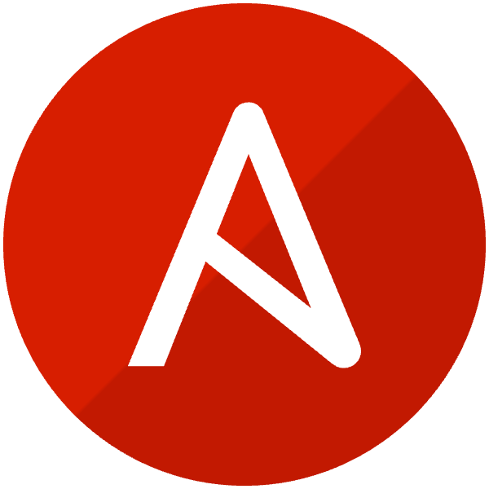
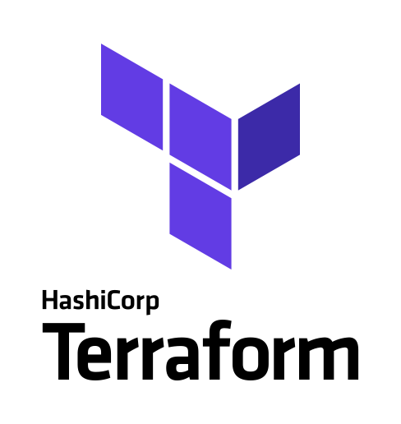
IBM Consulting Automation Transformation
INTERNAL ONLY
Positioning and opportunity identification
Target clients are those who:
Have limited or disparate automation
Using open source and need to scale (AWX, etc)
Moving to cloud native and need to modernize their automation (Packer, Aria, etc)
How we transact
Offering | Duration | Stakeholders
Automation Maturity Assessment | 2-8 Weeks | IBM
Solution Enablement | 6 Weeks | IBM, RH
Automation Transformation | 3+ Months | IBM
Features and deliverables
Automation Maturity Assessment – Identify areas of improvement and develop a targeted modernization strategy.
AWX to AAP
Cloud Native Transformation – Phased-approach for modernization centered around the development of an automation CoE. Often part of other deals, ie RHOV.
Prerequisites
Client has limited adoption of modern automation tooling.
Client uses, or is considering, cloud native platforms.
Forrestor Economic Impact of GitHub
Forrestor Total Economic Impact of Gitlab

Slide 37
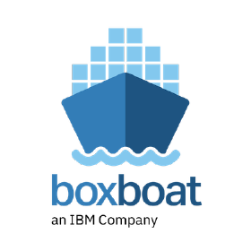
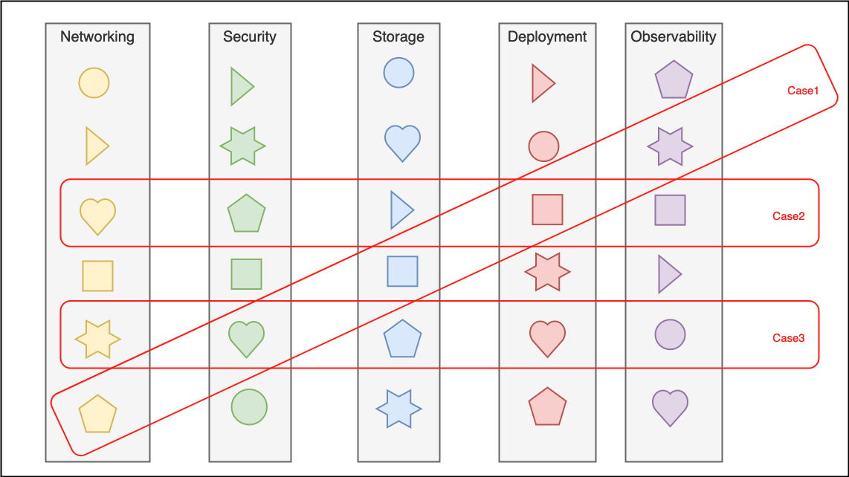

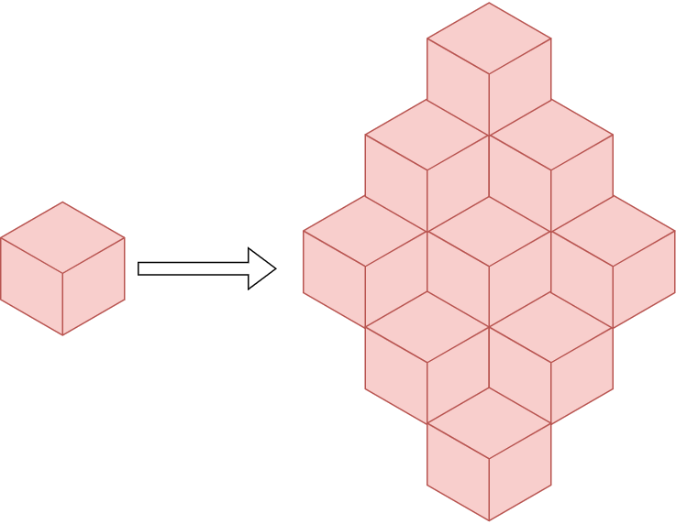
IBM Consulting Hybrid Cloud Transformation
INTERNAL ONLY
Positioning and opportunity identification
Target clients are those who:
Are looking to modernize their environments around cloud native;
Require a cloud native platform due to modernized COTS (ie Maximo).
How we transact
Offering | Duration | Stakeholders
HBD Maturity Assessment | 2-8 Weeks | IBM
Solution Enablement | 6 Weeks | IBM, RH
Hybrid Cloud Transformation | 3+ Months | IBM
Features and deliverables
Build a platform + operating framework + enablement plan to extract the value at scale that containerized workloads promise.
Maximize the value from your existing ecosystem of provider and tools.
Execute on your technology roadmap with confidence that your infrastructure can scale.
Develop a strategy that gives developers the choice they want in deployment, between clouds, on-prem, or on the edge.
Upskill your team to run with confidence, with a plan for future hires.
Funding Options
Hyperscaler Funding
OpenShift Everywhere (OSE)
IBM-T
Prerequisites
Client wants/needs to move to cloud native environment.
Client is using cloud native platforms and could benefit from optimization.
Forrestor Economic Impact of GitHub
Forrestor Total Economic Impact of Gitlab

Slide 38
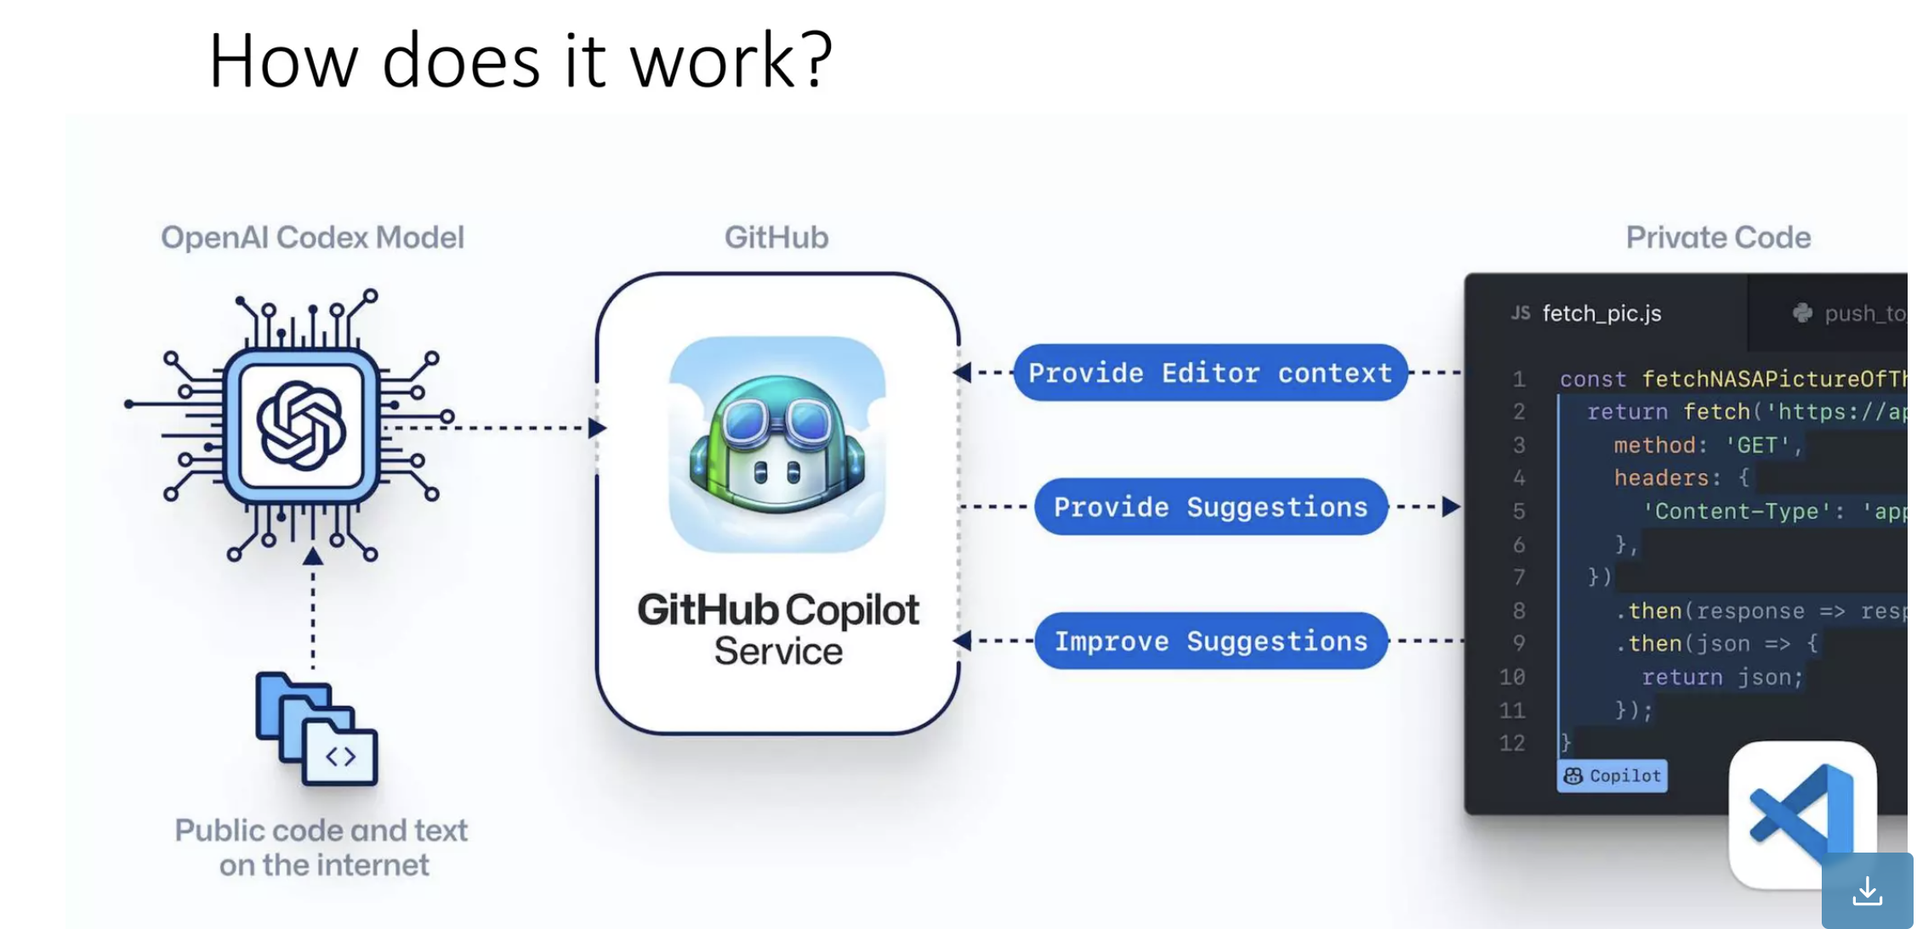
IBM Consulting GitHub Copilot Enablement
INTERNAL ONLY

Slide 39

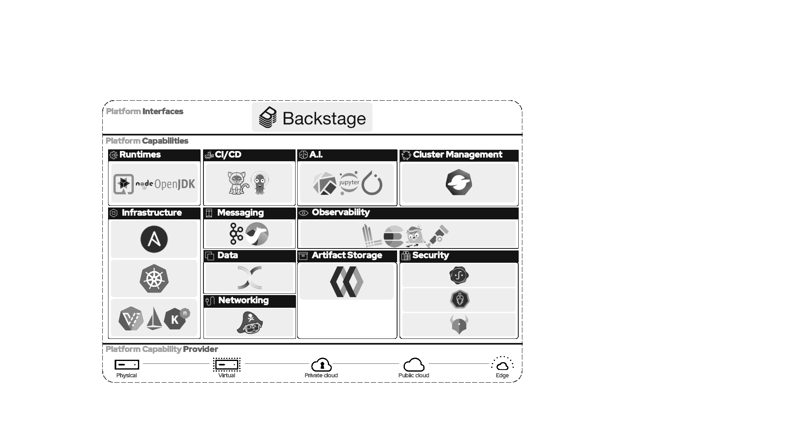
IBM Consulting The Modern Developer Ecosystem
INTERNAL ONLY
Positioning and opportunity identification
Modern development challenges our clients are facing:
Infrastructure provisioning and automation at scale.
The modern Developer Ecosystem has become increasingly complex.
Security needs to be “built-in” to the development lifecycle at a foundational level.
Adapting to the pressures of digital transformation
The mounting focus on platforms has led to an increase of overhead, tool sprawl, and cognitive load, and led to the necessity of an entirely new skillset.
How we transact
Offering | Duration | Stakeholders
DevEx Assessment | 2-8 Weeks | IBM
DevEx Solution Enablement | 6 Weeks | IBM, RH
DevEx Transformation | 3+ Months | IBM
Features and deliverables
DevEx Assessment – Identify areas of improvement through metrics, surveys, and discovery.
DevEx Solution Enablement – Enables targeted client teams on a specific DevEx solution using a series of workshops, office hours, and metrics-driven dashboards.
DevEx Transformation – Deploy and integrate selected DevEx tooling and Gen AI solutions, create CoE, & utilize Champions to expand adoption.
Funding Options
GitHub/Microsoft ECIF, AMP, GitFast
OpenShift Everywhere (OSE)
Key Technologies Included
Gen AI – WCA, RH Lightspeed, GH Copilot, GitLab Duo, Amazon Q, etc
IDP – Red Hat Developer Hub/Backstage, Port, Harness.io

Slide 40
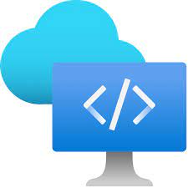
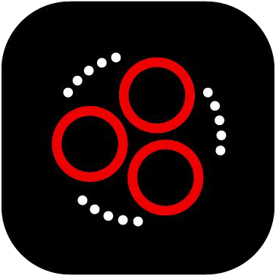

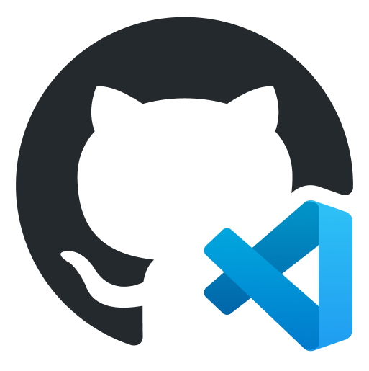
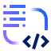
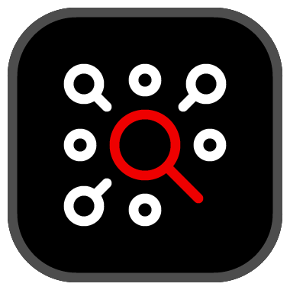

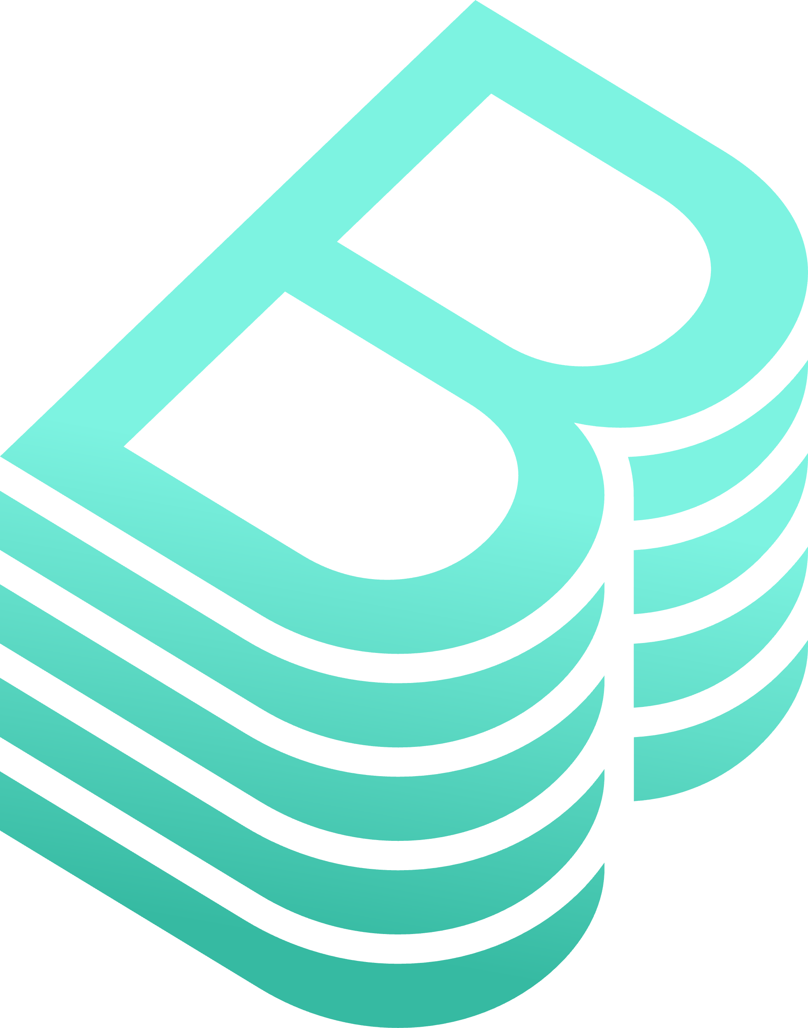

The Modern Developer Ecosystem
Unlock Developer Productivity with IBM Consulting
Boost developer efficiency and code quality
Reduce onboarding time
Provide secure, standardized building blocks for value creation
Ensure consistent deployment across hyperscalers and on-premise environments
Developer Toolchain Consolidation
Red Hat ACM
Azure DevBox
Red Hat Dev Spaces
GitHub Codespaces
Efficiency
Onboarding
Efficiency
Onboarding
Sustainable Impact
Sustainable Impact
WatsonX Code Assist
Time To Market
Time To Market
Red Hat Developer Hub
Generative AI
Internal Developer Portals
GitHub Copilot AI
Backstage
OpenAI CodeX
3x Efficiency Levers

Slide 41
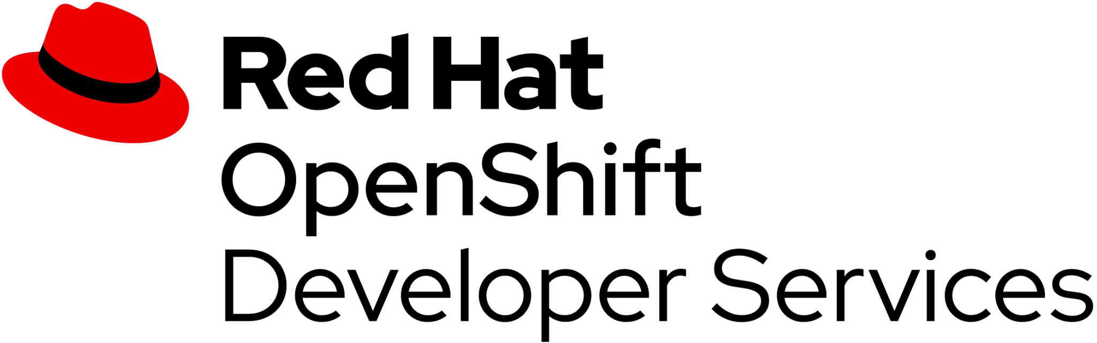
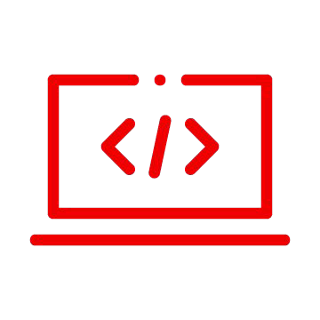


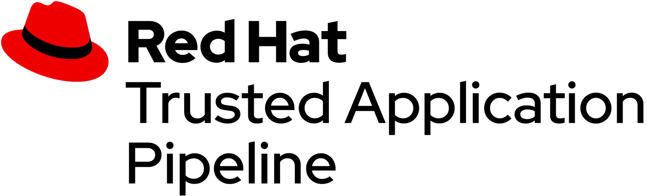
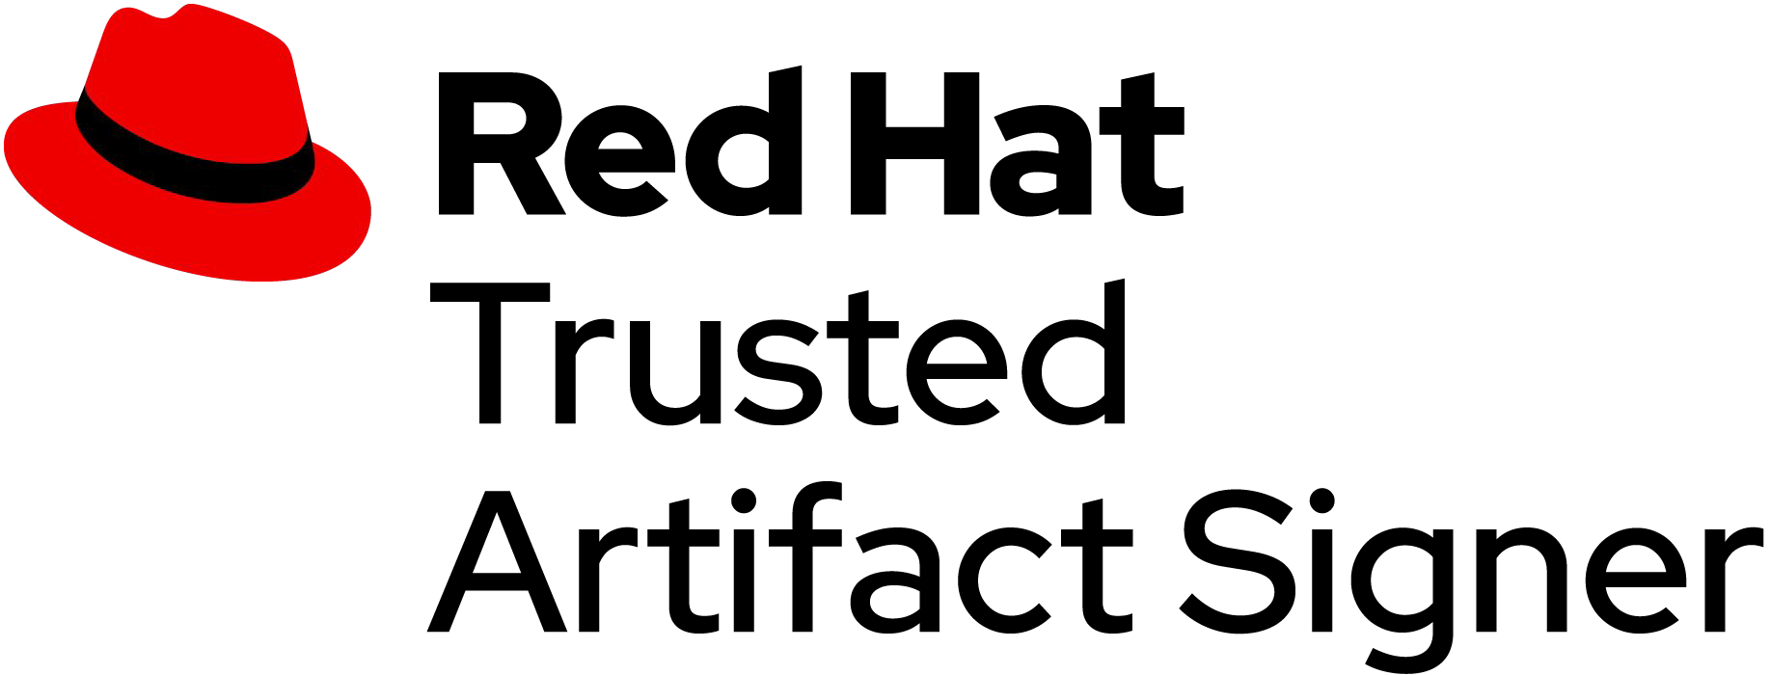
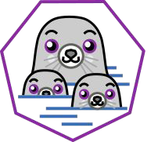
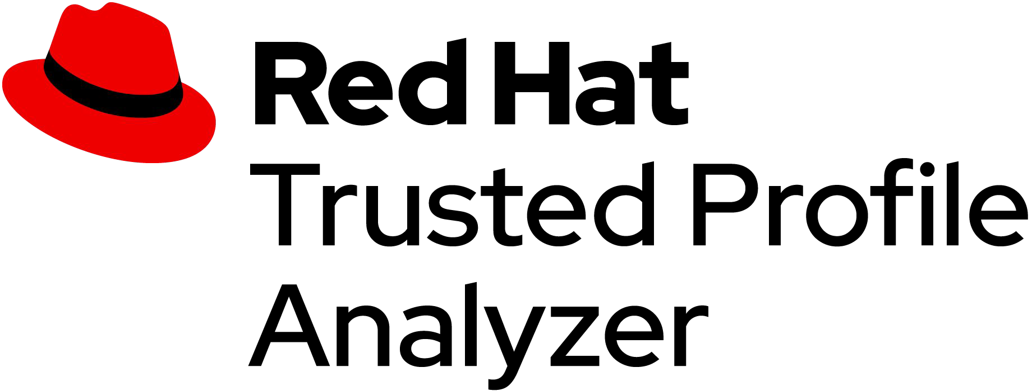




IDP: Internal Developer Portal
Trusted Software Supply Chain
Products that allow developers to quickly and securely deliver applications to production
Kube Developer Desktop Experience : Podman Desktop
Migration Services
Enabling platform engineers to more easily enforce operational controls and compliance across hybrid multi-cloud environments
Migration Services
IDE Tools
Application Networking Services
IDE Plugins
Service Interconnect
Dev Spaces

Slide 43
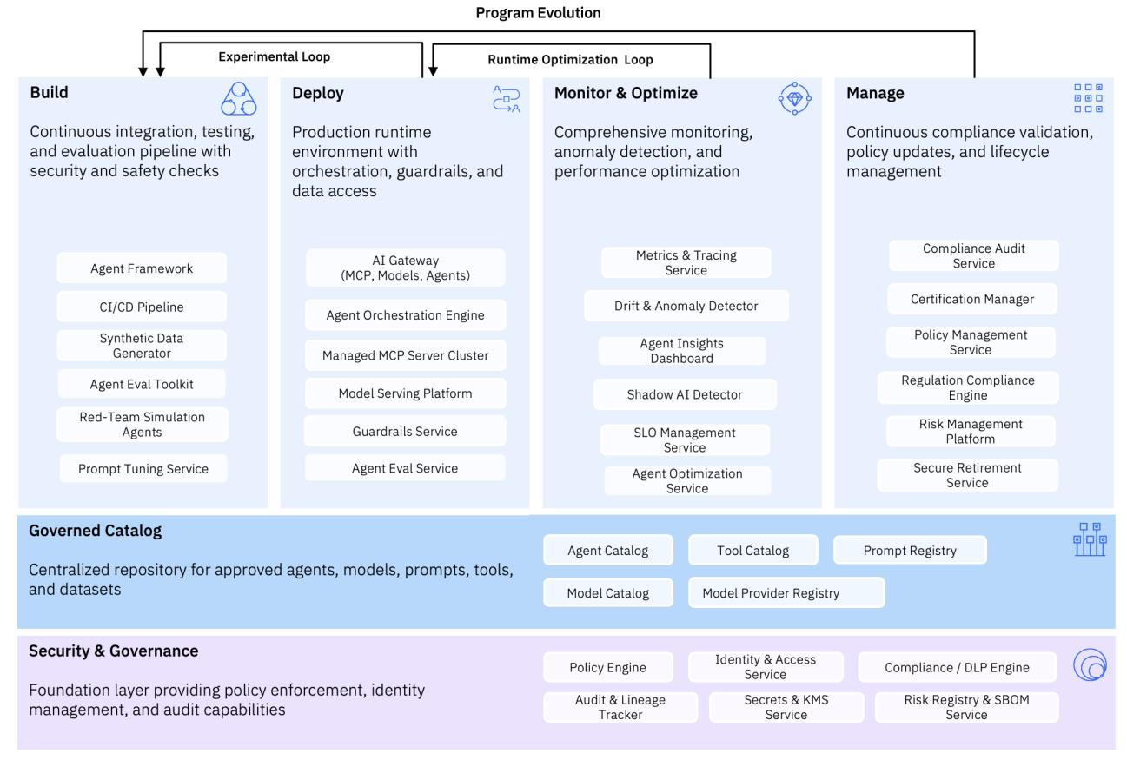

Slide 44



Business action: Automate global ops & deployment platform for Hybrid and gen AI
Hybrid Cloud Platform Sales Play: Enable Portable Workloads
Enterprise journey
1. Virtual machine estate is modernized and cloud-native
2. Establish a unified build, deploy, manage & monitor platform for apps
3. Infrastructure and tools are optimized to scale AI adoption
I
Enterprise Challenges and Business Outcomes¹:
Challenges
Sprawling legacy VM estate creates ops risks and hinders innovation
Disparate developer toolsets across teams reduces time to market
Sprawl of AI tool options limiting time-to-market of AI applications
Disparate tools, and platforms hinder scalability and time to market possible with hybrid cloud
Business Actions
Modernize, migrate, and centralize VMs for unified view and cost savings
Accelerate DevOps with hybrid cloud to speed up time-to-market
Improve time to market capability of AI tools
II
Consulting Offerings²:
Application Migration & Modernization (HCT)
Application Migration & Modernization (HCT)
AI Strategy & Governance (DTT)
IBM Consulting helps shift clients from infrastructure specific dev to uniform dev across environments
Consulting Offering
III
Client Technical Design Challenge³:
Technical Design Pts
Modernize VMs to cloud arch. for cost savings
Centralized VM and container management
Standardize & automate on a subset of tools
Ensure secure & continuous dev chain
Fine tune models with InstructLAB
Deploy & manage models across envs.
To automate a global deployment and ops platform, clients must standardize across tools, and platforms
IV
IBM Technology Products⁴:
Red Hat OpenShift Virtualization
IBM’s Hybrid Cloud products helps establish a centralized platform and tooling approach
Red Hat
Red Hat OpenShift Virtualization
Red Hat OpenShift Platform Plus
Red Hat Enterprise Linux AI
Red Hat OpenShift AI
Red Hat Ansible Automation Platform
¹ – additional details about Challenges/business actions upon request, ² – additional details about consulting offerings upon request, ³ – additional details about tech challenges upon request,
* – additional products outside of sales play that solve enterprise Challenge

Slide 45



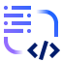
Business action: Embed at speed Gen AI models and tools across environments Data Platform Sales Play: Accelerate business impact of AI
Enterprise journey
1. Data, tools and models are unified for streamlined development
2. Gen AI implementations bridges skills gap & scales efficiently
3. Trusted AI systems minimize risks and increases business value
I
Enterprise Challenges and Business Outcomes¹:
Challenges
Disparate data sources, numerous models/tools delay dev. & scalability
Skills/talent shortage delay dev and limit enterprise-wide adoption
Poor governance and lack of trust in AI systems increase compliance risks
Enterprises need to scale genAI deployments to accelerate business value
Business Actions
Implement centralized AI platform to unify silos across enterprise
Deploy AI powered automation & low/no code tools for scalability
Integrate governance frameworks w. monitoring & ethical AI practices
II
Consulting Offerings²:
Hybrid Integration Services (HCT)
App Migration & Modernization (HCT)
App Migration & Modernization (HCT)
AI strategy & gov. (DTT)
IBM Consulting helps client embed tools and platforms needed to accelerate AI impact
Consulting Offering
III
Client Technical Design Challenge³:
Technical Design Pts
Unified platform built for hybrid environment
CI/CD pipelines for model training & depl.
Low/no-code development capabilities
Data cleaning & data quality for AI model tuning
To embed genAI across environments, clients need to solve enterprise level design challenges
IV
IBM Technology Products⁴:
IBM Data
IBM watsonx Orchestrate™
IBM watsonx. governance
IBM’s Data portfolio helps clients propel the next wave of AI productivity
IBM watsonx.ai™
IBM watsonx.ai™
IBM watsonx Code Assistant™
¹ – additional details about Challenges/business actions upon request, ² – additional details about consulting offerings upon request, ³ – additional details about tech challenges upon request,
* – HCT: Hybrid Cloud Transformation , ** – DTT: Data and Technology Transformation

Slide 46



Business action: Establish integrated operating model with unified TBM tools
Automation Platform Sales Play: Automate and Optimize Tech Investment and Operations
Enterprise journey
1. Hyperscaler costs must be controlled and accountable
2. Infrastructure utilization is optimized around usage and outcomes
3. Assets are comprehensively and proactively managed & maintained
I
Enterprise Challenges and Business Outcomes¹:
Challenges
Lack of transparency into runaway hyperscaler costs
Frequent infrastructure over & under run leading to inefficient usage
Cost of unplanned downtime is catastrophic for clients
Technology business management tools links business value and IT spend
Business Actions
Establish quantifiable transparency into cost and burn rate trends
Rationalize and leverage dynamic optimization for workloads
Enable a comprehensive and proactive asset management suite
II
Consulting Offerings²:
Cloud & Tech Strategy (HCT)
AI Ops (HCM)
Cloud & tech. strategy (HCT)
AI Ops (HCM)
Cloud Platform Eng Serv. (HCM)
AI Ops (HCM)
IBM Consulting helps shift clients from decentralized IT spend to optimized and AI managed IT investments
Consulting Offering
III
Client Technical Design Challenge³:
Technical Design Pts
Holistic E2E observability of spend
Provide real-time, actionable cost and perf. insights
Optimize IT consumption
AI powered resource orchestration
Unify asset management processes
Enable Predictive Maintenance
To reach an integrated operating model, clients must enact observability and rationalize existing infra & consumption
IV
IBM Technology Products⁴:
IBM Apptio
IBM’s Automation helps create an optimized, automated, and integrated E2E technology operation
IBM Automation
IBM Apptio
IBM Turbonomic
IBM Maximo Application Suite
IBM Cloudability
¹ – additional details about Challenges/business actions upon request, ² – additional details about consulting offerings upon request, ³ – additional details about tech challenges upon request,
* – additional products outside of sales play that solve enterprise Challenge

Slide 47





Business action: Optimize application observability & maintenance
Automation Platform Sales Play: Automate Application Resiliency
Enterprise journey
1. Application performance should be easily observed across the stack
2. Application performance should be simplified and optimized
3. One consistent environment should identify and enable app resiliency
I
Enterprise Challenges and Business Outcomes¹:
Challenges
Visibility gaps in hybrid infrastructure slows resolution of application issues
Lack of visibility in operational costs across teams and infrastructure
Disparate data silos and lack of prioritization creates overlapping work
Enterprises need to automate app resiliency to ensure consistent performance and efficiency
Business Actions
Create a single-pane-of-glass experience for app performance
Remove silos and provide context into app dependencies, and cost
Remove complexity and automate remediation to ensure resiliency
II
Consulting Offerings²:
Cloud & tech. strategy (HCT)
AI Ops (HCM)
AI Ops (HCM)
IBM Consulting helps shift clients adhoc app maintenance to centralized, and self-servicing app resiliency
Consulting Offering
III
Client Technical Design Challenge³:
Technical Design Pts
Holistic E2E performance monitoring and AI/ML analytics across hybrid cloud environments
Automated resource optimization
Identify & prioritize risks for critical apps
Automate response and remediation
To create optimized app performance , clients need to solve enterprise level design challenges
IV
IBM Technology Products⁴:
watsonx Code Assistant for Ansible Lightspeed
IBM’s Automation helps optimize how enterprise apps are observed and operated
IBM Automation and Red Hat
IBM Instana
IBM SevOne
IBM Turbonomic
IBM Instana
IBM Concert
Red Hat Ansible Automation Platform
¹ – additional details about Challenges/business actions upon request, ² – additional details about consulting offerings upon request, ³ – additional details about tech challenges upon request,
* – additional products outside of sales play that solve enterprise Challenge

Slide 48
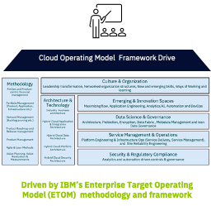
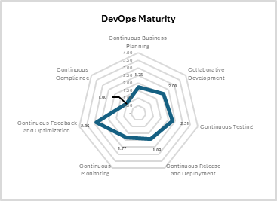
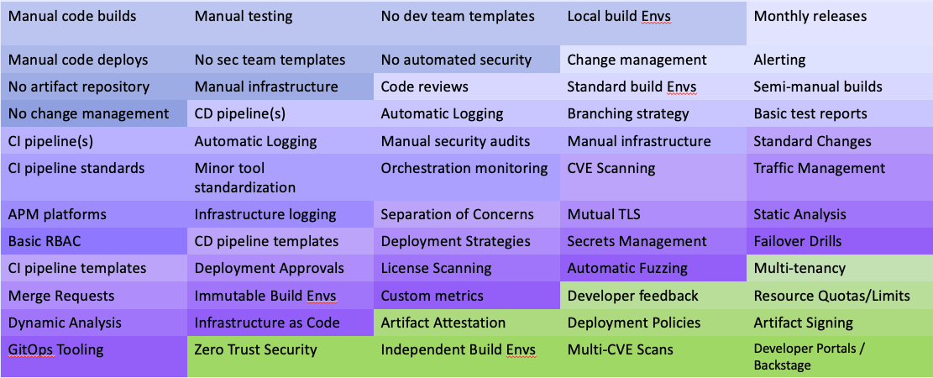
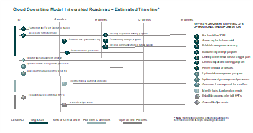
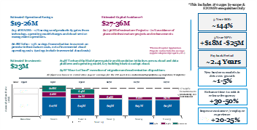
DevOps Model Maturity Assessment, Gap Analysis, & Deliverables
IBM will start with a maturity model assessment of client’s existing DevSecOps Center of Excellence, if relevant, to identify areas of inefficiency and growth opportunities to create a clear roadmap for modernizing practices that support their software development and delivery methods. We start with a DevSecOps assessment to provide client with a deeper understanding of their current state development and delivery practices which allows IBM to create a unified vision aligned to client's business objectives with the ultimate goal of reducing time-to-market, improving code quality, increasing efficiency, and reducing costs.
The result of the DevSecOps assessment is a prioritized capabilities roadmap with an implementation plan and a backlog of the necessary activities to modernize the DevSecOps CoE.
1. Current State Discovery
2. Maturity Gap Analysis
3. Key Deliverables
DevOps CoE Maturity Level
DevOps Maturity Scorecard
DevOps Capabilities Heat Map
LEVEL 1
No practice or automation followed
LEVEL 2
No Enterprise Standard is Defined
LEVEL 3
Standard is defined but not widely adopted
LEVEL 4
Standards are adopted, and team available to assist
LEVEL 5
Institutional
Adoption across
enterprise
Value Pillars Driving Maturity
Business Acceleration
Developer Experience
Prioritized Capability Roadmap
Business Justifications
Security & Compliance
Continuous Cost Optimization
Generative AI Amplification

Slide 49
Tailoring your DevSecOps Transformation
Foundation | Emerging | Evolving | Maturing | Leading | Innovating
Manual Code Builds Manual Testing No Dev Team Templates Local Build Environment Manual Code Deploys No Security Team Templates No Automated Security No Artifact Repository Manual Infrastructure No Change Management | CI Pipelines CD Pipelines Code Reviews Change Management Monthly Releases CI Pipeline Standards Automatic Logging Standard Build Dev Alerting APM Platforms Minor Toll Standardization Manual Security Audits Branching Semi-Manual Builds Basic RBAC Infrastructure Monitoring Orchestration Monitoring Basic Test Reports | CI Pipeline(s) CD Pipeline(s) Code Reviews Change Management Monthly Releases CI Pipeline Standards Standard Build Environment Minor Tool Standardization Manual Security Audits Branching Strategy Semi-Manual Builds Basic RBAC Basic Test Reports Automatic Logging Alerting APM Platforms Infrastructure Logging Orchestration Monitoring | CI Pipeline Templates License Scanning Static & Dynamic Analysis Automatic Fuzzing Merge Requests Immutable Build Environments CVE Scanning CD Pipeline Templates Infrastructure as Code Deployment Approvals Deployment Strategies Failover Drills GitOps Tooling Standard Changes Separation of Concerns Custom Metrics Mutual TLS Traffic Management Secrets Management | Zero Trust Security Multi-CVE Scans Artifact Attestation Artifact Signing Multi-tenancy Independent Build Environment Deployment Policies Resource Quotas & Limits Developer Feedback Developer Portals | Generative AI Self Service Internal Developer Portal Cloud IDEs

Slide 50







IT Operations have grown increasingly complex
2000’s
2010’s
2020’s
Current
Late 2020’s
Applications
Infrastructure
Traditional DC
Private Cloud
Public Cloud
Traditional DC
Private Cloud
Public Cloud
SaaS /
PaaS
IoT / Edge /Other
Traditional DC
Private Cloud
Public Cloud
SaaS /
PaaS
IoT / Edge /Other
AI &
Quantum
Traditional Architecture
Hyper Complexity Architecture
Waterfall
Agile / DevOps
AI driven
Developers are under immense pressure
76% of organizations state cognitive load is negatively impacting productivity
Home-grown / Monolith
Package/COTS
Cloud migrations & sprawl continue to add complexity
Containers/Hybrid/Microservices
96% of developers state that more automation would reduce cost and lower risk in software development
PaaS
Compliance and Security processes lack integration and automation causing a bottleneck for increased efficiency
Next Generation
Business & IT priorities lack common language
Average 9-18 Months to Deliver new Products
Notes:
With the introduction of public cloud providers, cloud native application and infrastructure models and the shift to “software defined everything”, the job of a software development team has become increasingly complex.
This is having a negative effect on business results with developers being under immense pressure, application and infrastructure environments sprawling with growing complexity, which is also increasing the challenge to drive standards across differentiated environments. These all add up to factors that delay time to market and alignment to drive meaningful business results.

Slide 51



IT Operations have grown increasingly complex
That’s a lot of spread!
Traditional DC
Private Cloud
Public Cloud
SaaS /
PaaS
IoT / Edge /Other
AI &
Quantum
Workloads
Workloads
Workloads
Management
Security
Workloads
Workloads
Workloads
Management
Security
Developer Enablement
Developer Enablement
Home-grown / Monolith
With each environment requiring its own tool stack, processes, etc
Package/COTS
Automation
Automation
Containers/Hybrid/Microservices
Cloud application platform
Cloud application platform
PaaS
Next Generation
Cloud 1
Cloud 2
Client IT environment
On-prem, Edge
Client IT environment
On-prem, Edge
Notes:
With the introduction of public cloud providers, cloud native application and infrastructure models and the shift to “software defined everything”, the job of a software development team has become increasingly complex.
This is having a negative effect on business results with developers being under immense pressure, application and infrastructure environments sprawling with growing complexity, which is also increasing the challenge to drive standards across differentiated environments. These all add up to factors that delay time to market and alignment to drive meaningful business results.

Slide 52




Multiple Paths,
One Destination
INTERNAL ONLY
Client | Migration Type | (Planned) Engagement Path
 | VMware to OpenShift Virt | OCP PoC -> Assessment -> Discovery -> Phased Migration
 | VMware to OpenShift Virt | Assessment -> RHOV PoC -> Discovery -> Phased Migration
 | VMware to OpenShift Virt | Cloud Native Maturity & Consolidation Assessment -> VMware Assessment -> Discovery -> Phased Migration
 | VMware to OpenShift Virt | VMware Assessment -> RHOV PoC -> Discovery -> Phased Migration

Slide 53






Core Migration Team and Squad: Shared Roles
Core Migration Team
Optional PoC
Squad
Program Manager
Lead Program Architect
Product Team
Program Manager
Lead Program Architect
App.
Consultant (Squad)
Sr. App. Architect
Automation Consultant
Platform Consultant
SRE Lead
Automation Consultant
Platform Consultant
PM Squad Support
* We assume that one squad will exist per Application to be migrated.
** Process is designed for the Core Migration Team to support multiple squads migrating applications at the same time.
*** App. Consultant (Squad) will move between Product Teams (applications) as they finish the migration process for previous workloads (apps).
IBM
Red Hat
IBM/RH
Customer

Slide 54
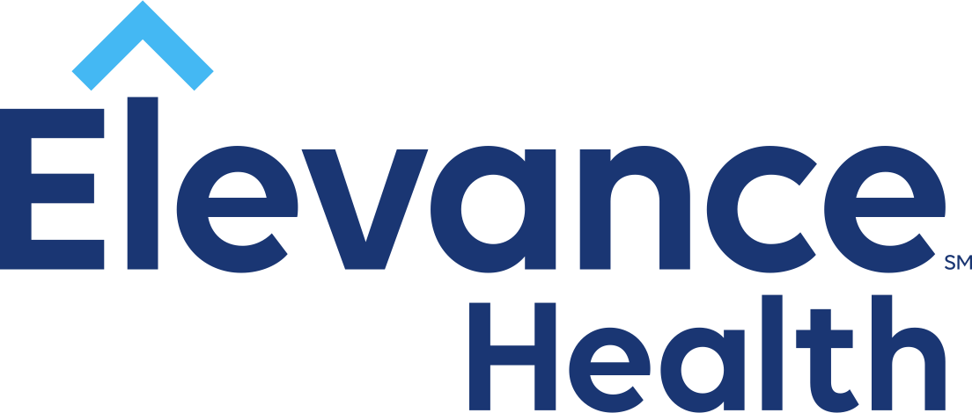
Client Success DevOps Transformation & Platform Enablement
INTERNAL ONLY
Business Challenges
Lack of toolchain or practice standardization
Underutilized tools and missing capabilities
The Solution
Pilot program rollout
Standardization behind single set of tools
Development of DevOps CoE
Elevance Medicare IT had a decentralized DevOps and SDLC approach which had resulted in toolchain creep and a lack of standardization.
Developers lacked the appropriate tooling across the org, with rampant “shadow IT”.
Elevance had acquired numerous tools and platforms but lacked the enablement to use effectively.
The existing DevOps landscape was hindering their adoption of cloud native solutions.
Value Delivered
Workload & Workflow Automation:
Developed automation for containerized workloads based on industry best-practices for optimal efficiency.
Reduced TTD from 3 days to 16 minutes and 37 seconds
Guidance & Extensibility:
Fostered a DevOps culture centered on best practices.
Architected and implemented reusable and extensible frameworks, simplifying future integrations.
Expansion:
Scaled transformation from initial PoC to cross-org modernization effort.

Slide 55
Client Success Modernizing the VMware Estate with OpenShift Virtualization
Business Challenges
Pricing increases from Broadcom
Inconsistency across various environments
Fear of further vendor lock-in
The Solution
Adopt OpenShift as the single platform of choice for all environments.
Packaged solution to meet all business needs included: RHOV, AAP, Terraform, ACM-V, and Dev Hub (RHDH).
Recent Broadcom pricing changes for VMware and other product lines led client to look for alternative solutions.
Growing concerns with existing virtualized platforms and related 3rd party tooling, including inconsistency across environments, resulted in the search for platform parity.
Primarily virtualization-focused landscape of vendor-supplied apps, with disparate containerized apps
Client chose OpenShift as their target platform of choice, consolidating VM-based workloads from VMware to OpenShift Virt (RHOV) environments on-prem and in the cloud.
Value Delivered
VMware Exit: The client was a large virtualization user but had no immediate interest in containers or microservices. However, a mix of concerns with the current market, lack of modernization potential, and increasing prices led to the search for a new virtualization solution.
RHOV enabled the client with a pure-virtualization solution while also enabling a standardized hybrid cloud-ready app platform.
TCO Business Case: To combat rising OpEx, RHOV was positioned to reduce TCO and YoY expenses. IBM presented business case to cut annual expenses by 50-75% with an immediate reduction in spend, even when accounting for services.
IBM Confidential

Slide 56
JOURNEY Accelerate Application Modernization, increase Business Agility and Reduce Platform operations costs with a container-first, Unified Multi-cloud Hybrid platform with end-to-end automation.
Our approach/ Solution
VMware to RH OpenShift Migration and Transformation journey by IBM Consulting
IBM C Phase-1 Signed: $800K services (670 VMs Tier 3/4 Apps) IBM C’s VM Migration Factory. RHOCP software + DELL Apex: $1.7M. Plus Red Hat ACM-V and RHDH (DevHub).
Pipe-2H: Ph-2 Scaled Migration by IBM-C $2M (1200 VMs), RHOVE $420K, Ansible $370K
Pull-in wins for IBM and Red Hat: New Automation platform (Ansible + Terraform based) to replace VMware ARIA, other related tools. IBM Cloud for RHOCP, VM, DR and Turbonomics.
Competition: Current client Vendors- Accenture (did VMware assessment), Tech Mahindra manages current IT infrastructure. Platform competition from MS Azure HCI and Nutanix.
Why We Won:
Superior client engagement, client-first approach and closed-loop feedback from client
‘One-IBM’ collaboration between IBM C, IBM T and RH and current vendor Dell.
’IBM Consulting-led’ Successful POC by our RH SMEs (Nick Miethe, Toure Dunnon, team). POC scoping, execution & post POC Exec demo. Leveraged funding via IBM -RH’s OSE campaign. This resulted in Technical win Vs competition, built IBM C’s trust & credibility.
CCF has been a VMware customer of 20 years. VMware admin/ platform team was resistant to change & needed a new Cloud Native skills transformation model. Leveraging this experiential POC, we built RHOCP Platform familiarity and demonstrated key Business value props that resonated with their Platform Ops, CTO office & cloud teams. We focused on Apps Transformation journey, better Developer experience, Business ROI, Cost optimization by running a Hybrid Platform for VMs & containers for a common CI/CD.
Client
Cleveland Clinic (CCF) is one of the largest, best healthcare systems, with 82K caregivers, 23 hospitals, 280 facilities globally. $16B Annual revenue, HQ in Cleveland, Ohio.
Current IBM Technology account (new win for IBM C)
Business
Challenge
Reduce Broadcom-VMware business risk and Eliminate Vendor Lock-in. Modernize Virtualization environment and protect from VMware’s price hikes, Product/ support changes, lack of innovation.
Application and Platform Modernization.
Reduce Tech Debt, replace VMware related 3rd party tooling, including inconsistency across environments.
Modernize a virtualization-focused landscape of vendor-supplied COTS Healthcare Apps (1800), with disparate containerized Apps. Dell, EMC and NetApp Hardware.
Target state
Client Outcomes
IBM Consulting chosen as the Transformation journey partner for this initiative.
RH OpenShift Container Platform chosen as the Unified Hybrid Multi-cloud management platform for both the monolith VMware VMs and cloud native containers, on-prem and in cloud. Enterprise open-source ML Ops Platform for AI.
A future proof Next Generation platform to accelerate CCF’s App modernization initiative and protects their Platform, Infra and Cloud services investments.
Standardization, advanced automation and better Developer experience.
Lower
Cost of Platform operations due to standardization, better workload management & optimal support costs
Faster
Time to market for new Apps & services. Remove VMware lock-in & freeing up the monolith VMs for modernization and containerization
Improved
Operational efficiency for managing VMware VMs & Containerized services on the same unified Hybrid-by-design platform & automated unified CI/CD pipeline
Reduced
Business Risk from burdensome Broadcom-VMware terms, predatory pricing & uncertain product roadmap. Reduce VMware dependency risk by 80% by 2026.

Slide 57
Thank you
2023 International Business Machines Corporation IBM and the IBM logo are trademarks of IBM Corporation, registered in many jurisdictions worldwide. Other product and service names might be trademarks of IBM or other companies. A current list of IBM trademarks is available on ibm.com/trademark
This document is current as of the initial date of publication and may be changed by IBM at any time. Statements regarding IBM’s future direction and intent are subject to change or withdrawal without notice, and represent goals and objectives only.
THIS DOCUMENT IS DISTRIBUTED “AS IS” WITHOUT ANY WARRANTY, EITHER EXPRESS OR IMPLIED. IN NO EVENT, SHALL IBM BE LIABLE FOR ANY DAMAGE ARISING FROM THE USE OF THIS INFORMATION, INCLUDING BUT NOT LIMITED TO, LOSS OF DATA, BUSINESS INTERRUPTION, LOSS OF PROFIT OR LOSS OF OPPORTUNITY.
or regulation
Client examples are presented as illustrations of how those clients have used IBM products and the results they may have achieved. Actual performance, cost, savings or other results in other operating environments may vary.
Not all offerings are available in every country in which IBM operates. It is the user’s responsibility to evaluate and verify the operation of any other products or programs with IBM products and programs.
The client is responsible for ensuring compliance with laws and regulations applicable to it.
IBM does not provide legal advice or represent or warrant that its services or products will ensure that the client is in compliance with any law or regulation.

Slide 58


OpenShift Virtualization Migration Roadmap
Virtualization Assessment
Product Setup and Migration Pilot
Plan for Migration
Migration at Scale
~ 2 weeks
Based on scoped complexity
Based on scoped complexity
Analyze current VM Architecture
Identify VM workloads
Define integrations
Understand day-2 operations
Propose a high-level design
Generate roadmap
Deploy OpenShift cluster with optional container storage integration
Enable & validate
virtualization features
Migration of initial VM workloads
Validate strategy for scale
Evaluate workload portfolio
Plan migration at scale with focus on modernization
Identify workloads for scale phase
Establish migration pattern
Migrate initial workloads
Assess progress
Repeat migration patterns
Validate migration
Retire legacy platform

Slide 59
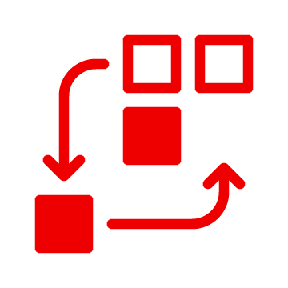

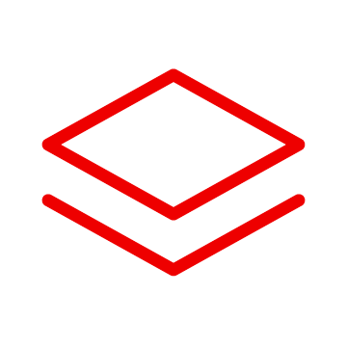
Virtualization Migration with IBM Consulting
Phase 1
Phase 2
Virtualization Migration Assessment
OpenShift Virtualization Factory Migration
Yes, let’s go
(Optional Phase 1.5)
OpenShift Virtualization
Understand the migration path and complexity
Migration of VM batches
Repeat migration patterns
Retire legacy platform
Measure value realized
OpenShift Virtualization Proof of Value
Show me we can
Proof of platform value for mass migration
Training
Mix of live and recorded enablement sessions from IBM and Red Hat.
Notes:
Want to understand your options, including rapid migration from your current platform? The Virtualization Migration Assessment helps organizations understand and align on the migration path to OpenShift Virtualization. Red Hat experts will assess your environment, hardware, integrations, and workload complexity to create a high level-design and gather requirements for the production pilot. The pilot migration of workloads provides the rest of the information needed to kick off a factory migration accelerated by Red Hat automation technologies.
Virtualization Migration Assessment - Datasheet

